Slide 1
Enabling Large Dynamic Neural Network Training with Learning-based Memory Management
Jie Ren*, Dong Xu, Shuangyan Yang, Jiacheng Zhao⁺, Zhicheng Li⁺, Christian Navasca§, Chenxi Wang⁺, Harry Xu§ and Dong Li
University of California Merced
*College of William and Mary
§ University of California Los Angels
⁺University of Chinese Academy of Sciences

Slide 2

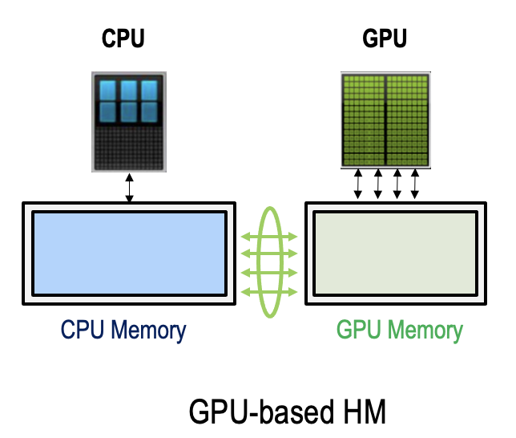
GPU memory capacity limits AI model training efficiency
Heterogenous memory is promising to address memory capacity limitation
Training AlphaFold2 (21 million parameters) with long amino acid sequences requires a large amount of memory.
Amino Acid Sequence Length | Memory Consumption for training with bs=1
800 | 16GB
2500 | 80GB

Slide 3
Prior efforts
For static neural network
Systematically plan tensor migration based on dynamic profiling of tensor accesses and allocation → dynamic profiling-guided optimization (PGO)
  Sentinel (HPCA’21)
Offload both computation and tensor to CPU and CPU memory to maximize GPU memory saving and minimize tensor migration volume
  ZeRO-Offload (ATC’21)
Step i
Step i+1
time
FWD & BWD
FWD & BWD
param update
GPU
CPU
GPU
Computation stream:
GPU->CPU
GPU->CPU
Swapping stream:
gradient offload
param swap

Slide 4
What about Dynamic Neural Network (DyNN)?
Dynamism in DyNN
  Adapt DyNN structures or parameters to the input sample
  Controlled by confidence-based criteria and gating functions using control flows
Dynamic routine
gated self-attention
Dynamism (gated attentions and dynamic routine) in AlphaFold
Notes:
Compared with static NN, DyNN reduces training cost yet improve model prediction perfor mance. DyNNs have shown high computational efficiency, strong representation capabilities and high adaptiveness in achieving desired tradeoffs between accuracy and efficiency on the fly.
AlphaFold takes protein sequences as input and produces highly accurate 3D structures as output,
In AlphaFold, the prediction of protein structures is not a one-step process. Instead, it involves multiple iterations where the model refines its predictions based on the information it has gathered so far.
This iterative process allows AlphaFold to capture the dynamic nature of proteins
AlphaFold takes protein sequences as input and produces highly accurate 3D structures as output, bridging the gap between sequence information and spatial arrangement in proteins¹.
How does DeepMind AlphaFold2 work? | Personal blog of Boris Burkov

Slide 5
What about Dynamic Neural Network (DyNN)?
Dynamism in DyNN
  Adapt DyNN structures or parameters to the input sample
  Controlled by confidence-based criteria and gating functions using control flows
Dynamic routine
gated self-attention
PGO cannot work
Dynamism (gated attentions and dynamic routine) in AlphaFold
Notes:
How does DeepMind AlphaFold2 work? | Personal blog of Boris Burkov

Slide 6
Two observations to drive our solution
The training process of an NN exhibits learnable patterns
Linear computation
Nonlinear computation
Notes:
To address this problem, we have two observations.
For example, linear computation is commonly followed by nonlinear computation (e.g., ReLU activation function).

Slide 7
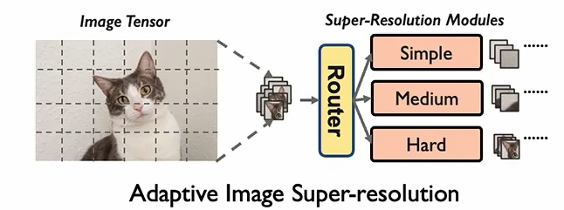
Two observations to drive our solution
The training process of an NN exhibits learnable patterns
The dynamic structure of a DyNN is built upon a series of decision-making processes to activate model components, which, in turn, impacts the access orders of tensor
Linear computation
Nonlinear computation
Notes:
To address this problem, we have two observations.
For example, linear computation is commonly followed by nonlinear computation (e.g., ReLU activation function).

Slide 8
Two observations to drive our solution
The training process of an NN exhibits learnable patterns
The dynamic structure of a DyNN is built upon a series of decision-making processes to activate model components, which, in turn, impacts the access orders of tensor
Linear computation
Nonlinear computation
The input sample to the DyNN provides indications on how such processes occur
A prediction model (called a pilot model) can be learned to enable automatic synthesis of the decision-making processes.
Notes:
To address this problem, we have two observations.
For example, linear computation is commonly followed by nonlinear computation (e.g., ReLU activation function).

Slide 9
Challenges
Design of pilot model
  When to prefetch which tensor from CPU memory to GPU memory
  Tradeoff: pilot model inference overhead vs. pilot model accuracy
Input sample
DyNN model
Pilot model
Guidance for tensor prefetching
Runtime system
Notes:
Predicting the exact execution order of operators cannot work

Slide 10
Challenges
Design of pilot model
  When to prefetch which tensor from CPU memory to GPU memory
  Tradeoff: pilot model inference overhead vs. pilot model accuracy
Input sample
DyNN model
Pilot model
Guidance for tensor prefetching
Runtime system
  How to minimize the performance impact of querying the pilot model for memory management?
Notes:
Predicting the exact execution order of operators cannot work

Slide 11
Design of pilot model
Input features
Pilot model
output

Slide 12
Design of pilot model
Input features
Pilot model
output
Input sample
Input features
Static structure of DyNN
Basic NN type of DyNN
Notes:
Basic type: CNN-based, LSTM-based, or transformer-based

Slide 13
Design of pilot model
Input features
Pilot model
output
Input sample
Simple representation
reduces input feature space
Input features
Static structure of DyNN
Informative representation
distinguish DyNN ops
Basic NN type of DyNN

Slide 14
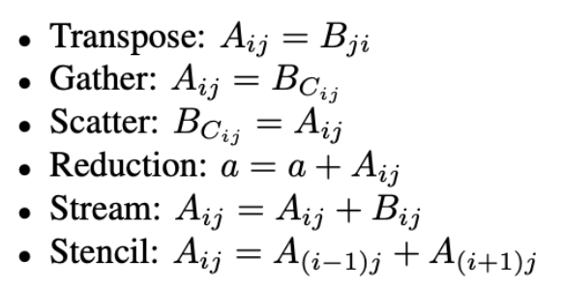
Encoding static structure of DyNN:
Idiom-based representation
Representation for operators
  Each operator can be characterized with six pervasive and expressive idioms
  We build a signature for each operator using the idioms
For example, operator: mse_loss_backward → [0,1, 1, 1, 1, 0]
count the occurrence of each idiom in the operator

Slide 15
Encoding static structure of DyNN:
Idiom-based representation
Representation for DyNN
  A collection of idiom-based representations for operators
Operator order in the static structure of DyNN
Notes:
The row order follows the operator order in the static structure of DyNN

Slide 16
Output of pilot model
The output format is based on execution blocks
An example of the pilot model output
Notes:
The output of pilot model uses a format based on execution blocks. The output will represent how operations in each execution block will be executed, and we use idiom-based representation for each execution block. We don’t predict for individual operators, because that makes the prediction model too large.

Slide 17
Output of pilot model
The output format is based on execution blocks
An example of the pilot model output
Easier prediction task and higher prediction accuracy
Shorter execution time of the pilot model
Notes:
The output of pilot model uses a format based on execution blocks. The output will represent how operations in each execution block will be executed, and we use idiom-based representation for each execution block. We don’t predict for individual operators, because that makes the prediction model too large.

Slide 18
Output of pilot model
Map (decode) pilot model-output to operators in DNN
An example of the pilot model output
Traverse the DyNN’s static architecture, meanwhile bookkeeping the operators info
Notes:
The output of pilot model uses a format based on execution blocks. The output will represent how operations in each execution block will be executed, and we use idiom-based representation for each execution block. We don’t predict for individual operators, because that makes the prediction model too large.

Slide 19
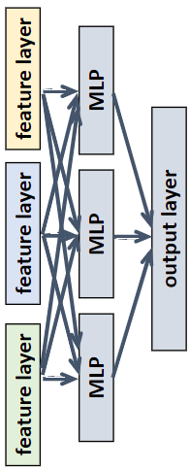
Topology of pilot model
A lightweight MoE model
Input embedding
Encoded static
structure of DyNN
DyNN model type
(Transformer-based, LSTM-based
CNN-based)

Slide 20
Topology of pilot model
A lightweight MoE model
Input embedding
Only one MLP is activated
Using three MLPs in parallel to reduce inference time of the pilot model
Encoded static
structure of DyNN
DyNN model type
(Transformer-based, LSTM-based
CNN-based)

Slide 21
Training of pilot model
A training sample
Input vector
Output vector

Slide 22
Training of pilot model
A training sample
Input vector
Output vector
Encoding of static structure of DyNN
An input sample to DyNN

Slide 23
Training of pilot model – data collection
A training sample
Input vector
Output vector
Encoding of static structure of DyNN
Encoding of static structure of DyNN
“Correct” operator-execution trace
An input sample to DyNN
An input sample to DyNN

Slide 24
Training of pilot model – data labeling
A training sample
Input vector
Output vector
Encoding of static structure of DyNN
Encoding of static structure of DyNN
“Correct” operator-execution trace
An input sample to DyNN
An input sample to DyNN
Optimize the trace using Sentinel
Operator-execution trace with resolved dynamism

Slide 25
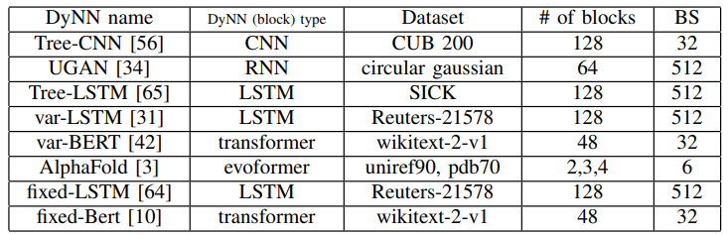
Evaluation: experimental setup
Hardware
  An NVIDIA RTX6000 GPU with 23GB memory, and dual Intel Xeon CPUs and 186 GB CPU memory
  Two high-end servers, each with four 80GB NVIDIA A100 GPUs, and dual Intel Ice Lake CPUs and 500 GB CPU memory
Workloads

Slide 26
Evaluation: experimental setup
Baselines
DTR
  Free memory space for activation tensors when the GPU memory is not large enough
  Rematerialize the freed activation when needed
Unified virtual memory (UVM)
Zero-Offload
  Work for static NN only
  Offload optimizer states and full-precision parameters only

Slide 27
Evaluation: breaking memory capacity wall
The largest trainable models (varBERT) on a single A100 with 80GB memory
# of parameters | PyTorch Only | Unified virtual memory | DTR | DyNN Offload
Deep Var-BERT | 3.85 Billion | 7.5 Billion | 3.85 Billion | 31.25 Billion
Wide Var-BERT | 3.85 Billion | 4.5 Billion | 6.5 Billion | 20.2 Billion
DyNN-Offload enables up to 6.3x larger model training.
Notes:
To make the comparison fair, we set the same maximum-runtime-overhead (200%) for UVM.
Training a very deep model with DTR suffers from system crashes because of DTR’s internal mechanism to track tensor lifetime

Slide 28
Evaluation: DyNN training time
UVM performs worst in almost all cases, because tensor migration largely happens on demand
DyNN-Offload outperforms DTR by 35% on average
For static NN, DyNN-Offload outperforms ZeRO-Offload by 33% on average

Slide 29
Summary
DyNN is the future of large AI models
  It is believed that DyNN is one of a few techniques to improve efficiency and resource utilization of future large models
Building a fast, accurate, and live ML model to guide performance optimization and analysis for DyNNs is feasible
Building a new abstract to encode DyNN structure is the key

Slide 30
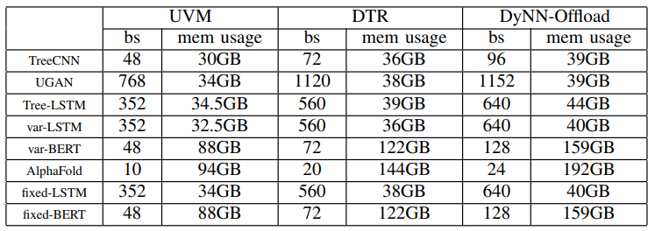
Evaluation: breaking memory capacity wall
The maximum trainable batch size on a single A100 with 80GB memory
To make the comparison fair, we set the same maximum-runtime-overhead (200%) for UVM, DTR, and DyNN-Offload.
With UVM, DTR and DyNN-Offload, the largest batch size is 1.17×, 1.7×, and 3.6× larger, compared with native PyTorch

