Slide 1
Betty: Enabling Large-Scale GNN Training with Batch-Level Graph Partitioning and Tiered Memory

Slide 2
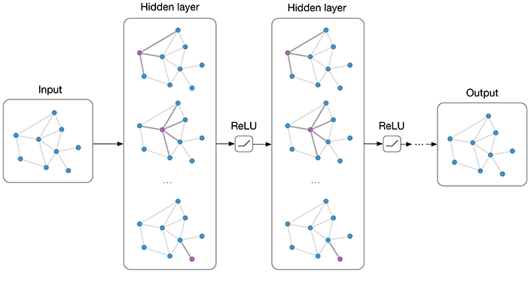
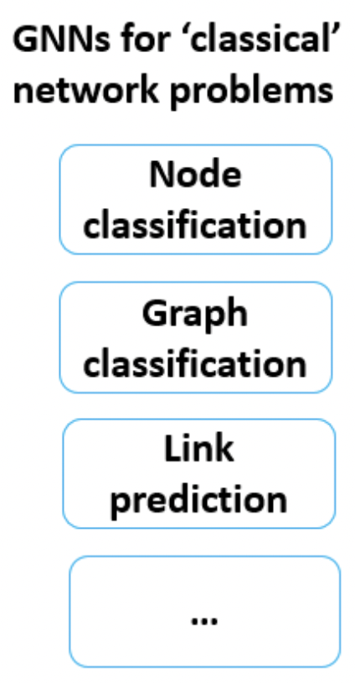
Background: Graph neural network (GNN) becomes prominent
An example of GNN: Multi-layer Graph Convolutional Network (GCN)
https://github.com/tkipf/pygcn

Slide 3
Background: operations in GNN
Downstream tasks: e.g., node classification
Center node
Aggregate
Combine
Collecting features vectors of each center node’s neighbors
Updating the feature vector of each center node
Performing neural operations for each center node using neighbors’ features.
Notes:
Center node = destination node

Slide 4
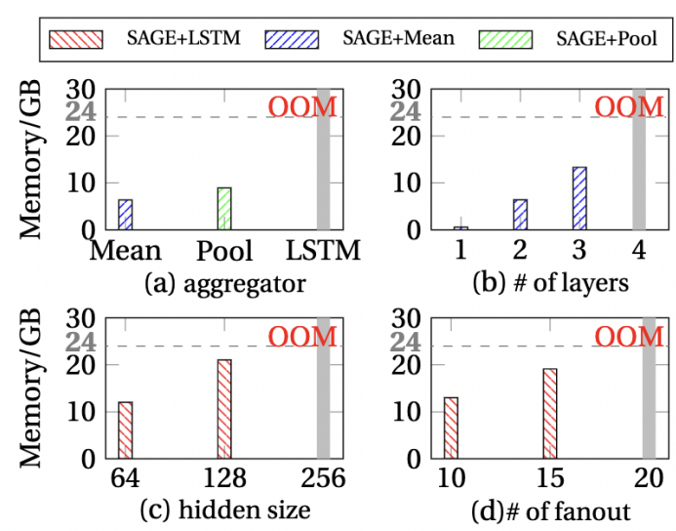
GNN suffers from the memory capacity problem
Advanced aggregator
Deeper aggregation
Larger fanout degree
Wider hidden size
The memory consumption of running GraphSAGE on ogbn-products

Slide 5
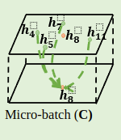
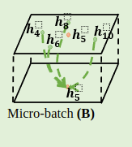
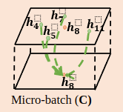
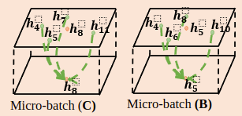
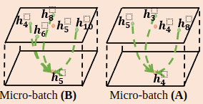
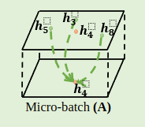
Our solution: batch-level partition
Forward Propagation
Backward Propagation
CPU
GPU
CPU Memory
GPU Memory
graph
partition
7
4
8
…
3
$$h_{8}^{}$$
11
0
5
2
10
Accumulated gradients
1
6
9
update
GNN Model parameters
Basic idea
Partitions a batch into micro-batches
Calculates the loss and gradients after each micro-batch
Accumulates the gradients over consecutive micro-batches
Updates the parameters based on the accumulated gradients from the entire batch.

Slide 6
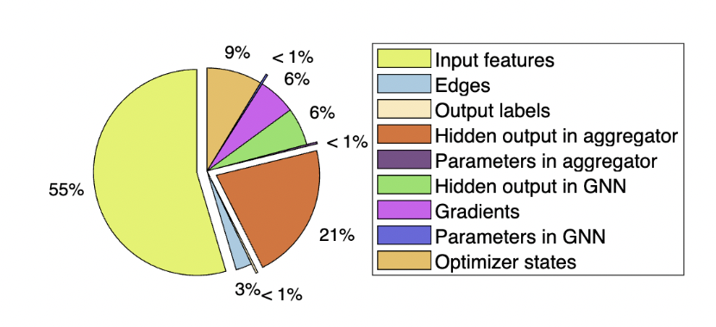
Why is the batch-level partition effective?
The GPU memory consumption of 1-layer GraphSAGE model with Mean aggregator using the dataset ogbn-products.
In GNN, the input node features usually take the largest portion of the total memory consumption
Batch-level partition reduces the input node features in a micro-batch

Slide 7
Why is the batch-level partition effective?
Traditional Mini-batch training vs. our micro-batch training
Forward Propagation
Backward Propagation
Epoch t
Mini-batch Training
Epoch (t+1)
Epoch t
Micro-batch Training
Epoch (t+1)
Mini batch
Mini batch
Mini batch
Mini batch
Micro batch
Micro batch
Micro batch
Micro batch
Update
Update
Update
…
Update
iter1
iter N
GNN Model Parameters
GNN Model Parameters
Batch-level partition achieves the same convergence as full-batch training without any changes on hyperparameters or optimizers
Notes:
Batch-level partition is a system-level optimization transparent to the model training process.

Slide 8
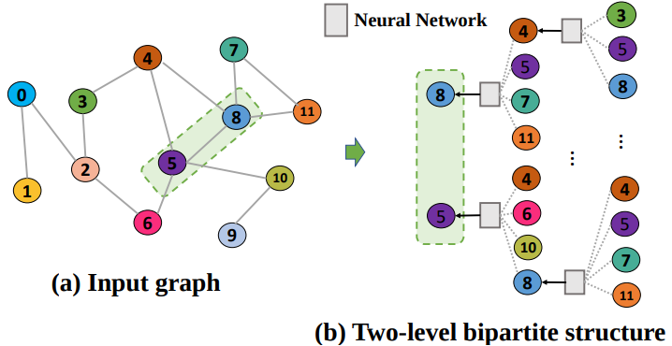
Challenges of using batch-level partition
Bipartite structure in GNN causes challenges
The output and input features in GNN have N:M mapping relationship (not 1:1 in traditional DL)
(a) Input graph
(b) Two-level bipartite structure
An example of the bipartite structure in GNN

Slide 9
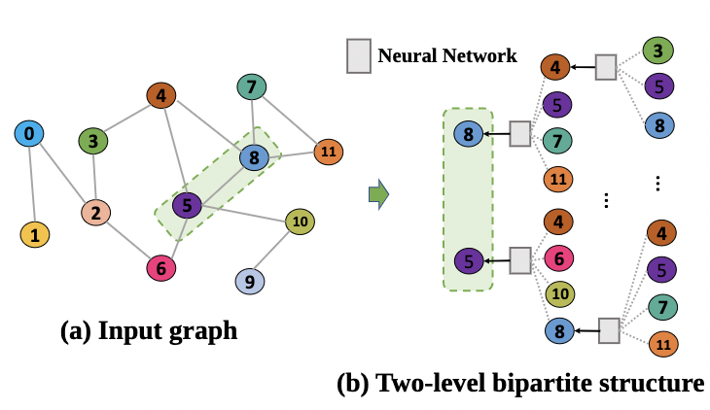
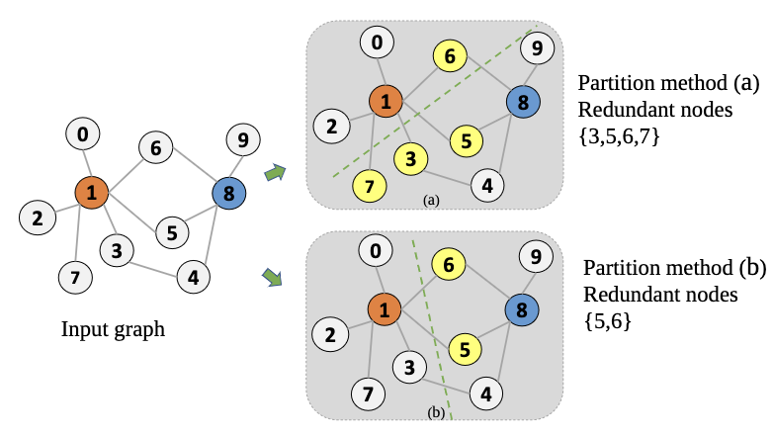
Challenges of using batch-level partition
An example of 2-level bipartite structure in GNN.
An example to depict the node redundancy problem.
Nodes 1 and 8 are the output nodes
The bipartite structure causes high redundancy after the partition
Notes:
an input node might be duplicated into multiple micro-batches if it is a shared neighbor across several nodes that get partitioned into different micro-batches.

Slide 10
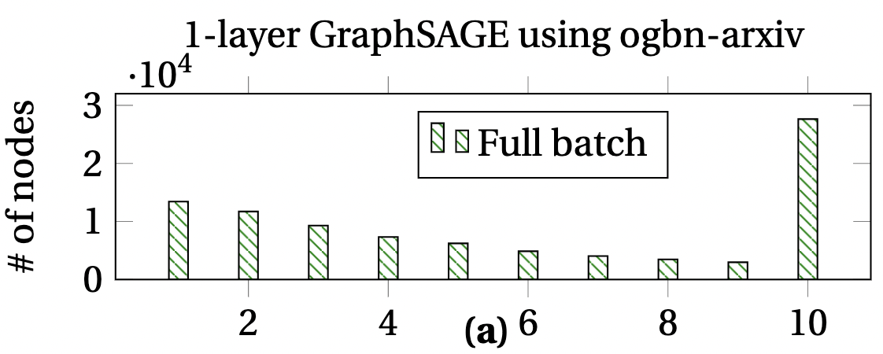
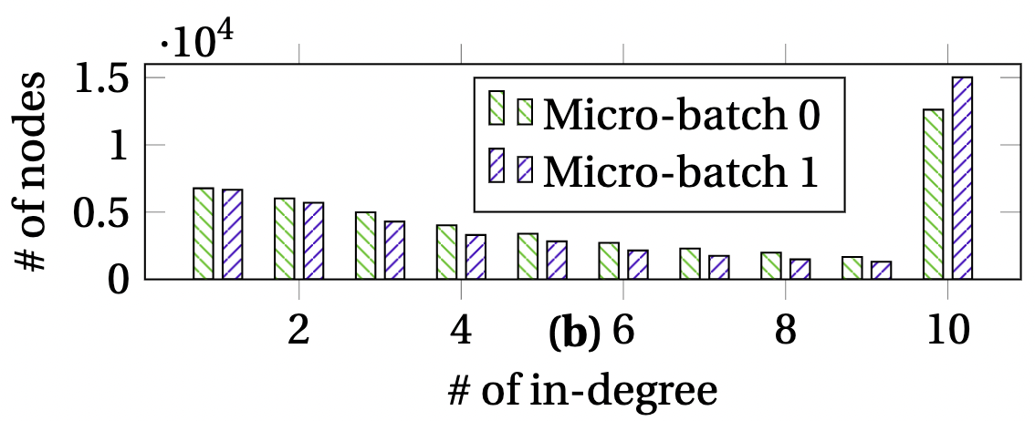
Challenges of using batch-level partition
A partition strategy can cause load imbalance, increasing peak memory footprint
1-layer GraphSAGE using ogbn-arxiv
(a) The in-degree distribution of destination nodes​
(b) The in-degree distribution for two micro-batches
Indegree-bucketing leads to the bucketing explosion and partition imbalance.
Notes:
using DGL as an example. Existing GNN frameworks often employ in-degree bucketing algorithms to perform the aggregation operation, i.e., the nodes with the same in-degrees are gathered into the same bucket (called NodeBatch) to improve computation efficiency of aggregation [40].
as the graph size increases, the in-degree often follows a power law distribution and may have a long tail [1], where the accumulated nodes that fall into this long tail become intractable.

Slide 11
Our solution: Betty
A new training method to make GNN training more scalable and accessible via batch-level partitioning on heterogeneous memory
Enable GNN training with billion-scale graphs without OOM and losing accuracy
https://github.com/PASAUCMerced/Betty

Slide 12
Minimize redundancy
Transforming our problem into a problem solvable by the traditional graph partition algorithm for the min-flow cost cut problem
Embedding redundancy info into the graph
0
Output node
5
1
1
2
1
1
Input graph
2
2
3
0
3
1
4
An example of redundancy-embedded graph (REG)
Notes:
Create an example

Slide 13
Build redundancy embedded graph
0
5
1
2
1
1
REG of the output nodes
1
2
A: the adjacency matrix of the graph
2
3
1
0
3
4
set diagonal zero
remove non-output nodes
 | 0 | 1 | 2 | 3 | 4 | 5
0 |  | 1
1 | 1 |  | 1 |  |  | 1
2 |  | 1 |  | 1
3 |  | 1 | 1 |  | 1 | 1
4
5
 | 0 | 1 | 2 | 3 | 4 | 5
0 |  | 1
1 | 1 |  | 1 | 1
2 |  | 1 |  | 1
3 |  |  | 1
4 |  |  |  | 1
5 |  | 1 |  | 1
 | 0 | 1 | 2 | 3 | 4 | 5
0 | 1 |  | 1 | 1
1 |  | 3 |  | 2
2 | 1 |  | 2 | 1
3 | 1 | 2 | 1 | 3
4
5
 | 0 | 1 | 2 | 3 | 4 | 5
0 | 1 |  | 1 | 1
1 |  | 3 |  | 2
2 | 1 |  | 2 | 1
3 | 1 | 2 | 1 | 3
4
5
Transpose(A) * A
C

Slide 14
Memory-aware partitioning to meet memory capacity constraint
Trial-and-error?
How many partitions are sufficient?
Modeling and estimation of memory usages
Notes:
LSTM constant 18 https://arxiv.org/pdf/1402.1128.pdf
implement fused message passing, combining the send and recv into one operation, to avoid explicit message storage. (it's faster and saving memory)
https://www.dgl.ai/blog/2019/05/04/kernel.html

Slide 15
Modeling of memory usage
The number of GNN model parameters
The total dimensions of input features
The number of output node labels
The size of hidden layers’ output in GNN
LSTM:
The size of intermediate results from the aggregator
$$\sum_{i=1}^{fanout}{i×B_{i}×H×18}$$
The number of gradients
Aggregator-dependent
The number of optimizer states
The size of bipartite structures
$B_{i}$: # of nodes with the degree of $i$
$H$: Dimensions of input features

Slide 16
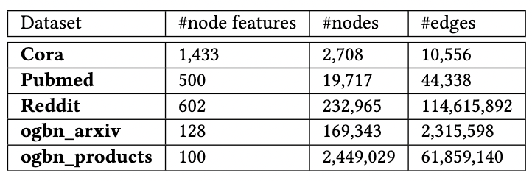
Evaluation
Platform
Two Xeon E5-2698 v4 CPUs (40 cores running at 2.20GHz) and an NVIDIA Quadro RTX 6000 GPUs (24GB).
Python 3.6, Pytorch v1.7.1 and DGL v0.7.1
Training datasets
Workloads
Five datasets with various features.
GNN models: GraphSage and GAT.

Slide 17
Experimental Results
9 micro-batches
3 and 60 micro-batches
3 and 32 micro-batches
2 and 13 micro-batches
The memory consumption of running GraphSAGE model with ogbn-products
Betty breaks the memory capacity constraint

Slide 18
Experimental Results
The tendency of peak memory consumption and training time per epoch as the number of micro batches increases.
We effectively reduce max memory consumption as the number of batches increases
Training time increases as the number of batches increases
But Betty is 36.4% faster than the mini-batch training (alternative approach)
Notes:
Compared with the traditional methods of using mini-batch training to break the wall, micro-batch training is 36.4% faster (using 2-layer GraphSAGE with the mean aggregator and OGBN-products) and reduces hardware cost. There is a batch size where there is a good balance between the reduction of peak memory consumption and training time.

Slide 19
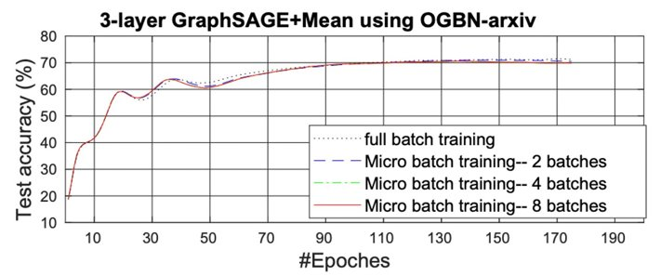
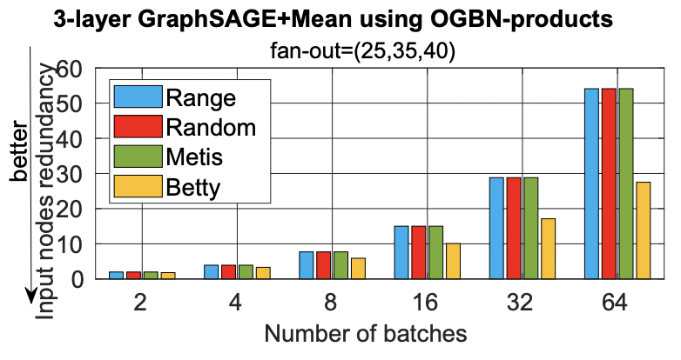
Experimental Results
Convergence curves for full-batch training and micro-batch training with three different numbers of batches.
Evaluation of input nodes redundancy
Betty reduces the node redundancy by 49.2% (when using 64 batches) and 28.4% on average, compared with three other partition methods
Model convergence is not impacted by Betty and micro-batch training

Slide 20
Conclusions
Unique memory access patterns and data structures in GNN calls for a new method to use heterogeneous memory
Betty enables large-scale GNN training with large and complex graphs on single GPU without losing training accuracy and OOM.

