Slide 1
Yashme: Detecting Persistency Races
Hamed Gorjiara
University of California, Irvine
Harry Xu
University of California, Los Angeles
Brian Demsky
University of California, Irvine
Notes:
Hi everyone, my name is Hamed Gorjiara from UC Irvine. Today, I’m gonna talk about our system, Yashme, which is designed to automatically detect persistency races in the programs.
This is a joint work with my advisor and co-advisor, Brian Demsky from UC Irvine and Harry Xu from UCLA.

Slide 2
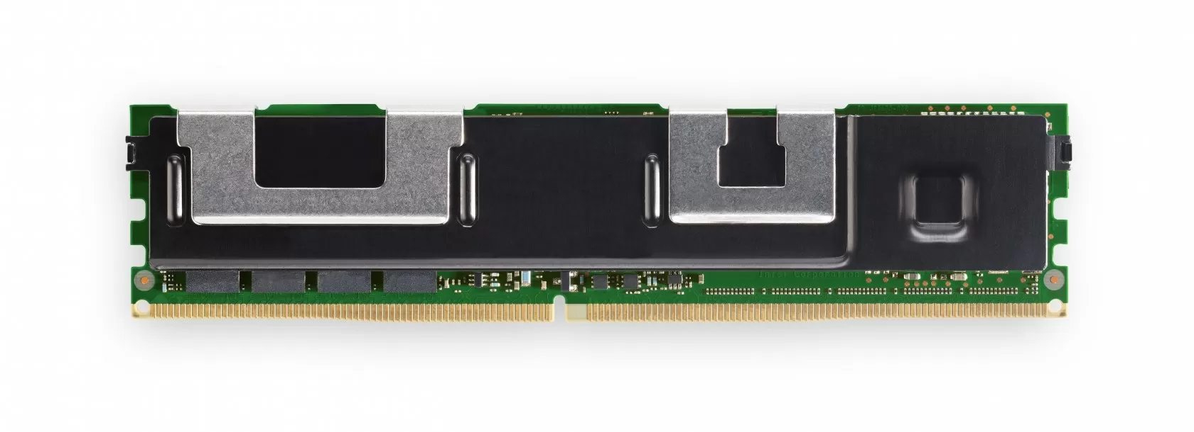
Persistency Race
Compiler
Cache
CPU Cache
Program Code
CPU
PMEM DIMM
Notes:
During this talk, I present a new class of persistency bugs that we call it Persistency Race…

Slide 3
Persistency Race
Compiler
Cache
CPU Cache
Program Code
CPU
PMEM DIMM
Notes:
…which arises because of the interaction between compiler optimizations and persistent memory.

Slide 4
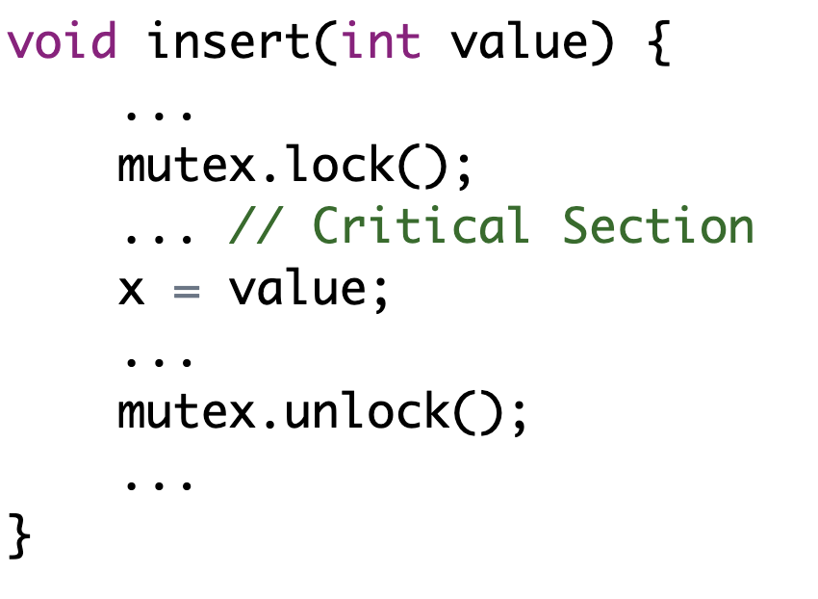
Compilers
C/C++ memory models allow compilers to assume the programs are race free!
Notes:
Most programming languages specifications including C and C++ memory models provide compilers with the freedom to assume the programs are race free, and other threads will not read from a non-atomic store until a release operation such as unlock is executed.

Slide 5
Compilers
C/C++ memory models allow compilers to assume the programs are race free!
Compilers are free to perform optimizations on x leading to store tearing and store inventing
Notes:
This race freedom assumption allows compilers to perform different optimizations on non-atomic variables leading to splitting them into multiple store instructions (which also known as store tearing), or generate new store instructions to temporarily stash intermediate results in the memory location, if the compiler runs out of registers (which this is referred to as store inventing). So, …

Slide 6
Compilers
C/C++ memory models allow compilers to assume the programs are race free!
memory location x must have the last stored value before a release operation
Notes:
… the compilers only need to guarantee that the optimized code does not store to any memory locations that the original code did not, and a store takes full effect before the next release operation such as unlock or store release.
However, with persistent memory, system crashes can result in such temporarily values become persistent. To illustrate the idea …

Slide 7
Persistency Race
x=0xFFFF
Compiler
Cache
CPU Cache
Program Code
CPU
Pre-crash Code
x
0xAA
0xAA
x = 0xFFFF
flush(&x)
PMEM DIMM
x is non-atomic
Notes:
…let’s look at this piece of code where, the program writes the value of quadruple FFFF to variable x and then flushes this variable. As you can see on the slide, X initially contains the value of quadruple AAAA in the memory.
Variable x is Non-atomic. Therefore,

Slide 8
Persistency Race
Store tearing
x₁=0xFF
x₂=0xFF
Compiler
Cache
CPU Cache
Program Code
CPU
Pre-crash Code
x
0xAA
0xAA
x = 0xFFFF
flush(&x)
PMEM DIMM
Notes:
… the compiler can freely decide to split this store into multiple store instructions X₁ and X₂.

Slide 9
Persistency Race
x₁=0xFF
x₂=0xFF
Compiler
Cache
CPU Cache
Program Code
CPU
Pre-crash Code
x
0xAA
0xAA
x = 0xFFFF
flush(&x)
PMEM DIMM
Notes:
When the program is running, CPU executes store X₁ first, and the cache …

Slide 10
Persistency Race
x₂=0xFF
x₁=0xFF
Compiler
Cache
CPU Cache
Program Code
CPU
Pre-crash Code
x
0xAA
0xAA
x = 0xFFFF
flush(&x)
PMEM DIMM
Notes:
… is updated. If there is not enough space on the cache, the cache writes back dirty cache lines to the memory. Consequently, …

Slide 11
Persistency Race
x₂=0xFF
Compiler
Cache
CPU Cache
Program Code
CPU
Pre-crash Code
x
0xFF
0xAA
x = 0xFFFF
flush(&x)
PMEM DIMM
Notes:
… X₁ possibly can become persistent. In this state, if the system crashes,

Slide 12
Persistency Race
Volatile
Compiler
Cache
CPU Cache
Program Code
CPU
Crash
x
0xFF
0xAA
PMEM DIMM
Notes:
… X₂ store is lost since CPU registers and the content of cache are volatile.

Slide 13
Persistency Race
Compiler
Cache
CPU Cache
Program Code
CPU
Invalid value for x
x
0xFF
0xAA
PMEM DIMM
Notes:
In the post-crash execution, when the program reads from the variable x, it observes an invalid partially persisted value of FFAA.
Variable X can be a pointer, where this invalid value may lead to a program crash due to illegal memory access.
We refer to this bug as persistency race since a pre-crash execution thread races with the crash, and a post-crash thread observes the effects of the race.

Slide 14
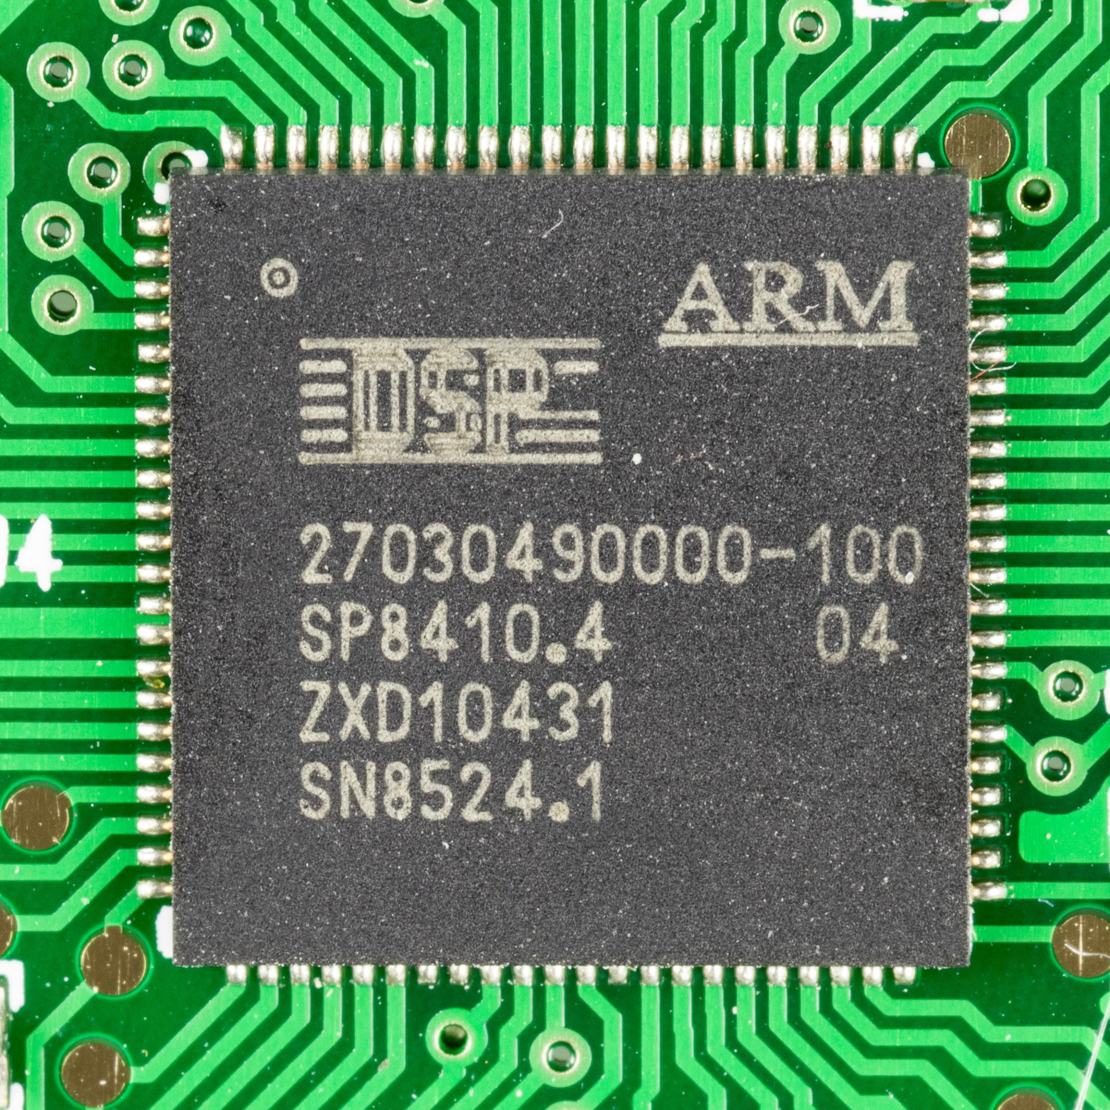
How Realistic are Persistency Races?
Compiler
ARM64 CPU
Pre-crash Code
-O1
x = 0x1234567812345678
flush(&x)
Optimization
Assembly Code
adrp x0, x
add x1, x0, :lo12:x
mov w0, 22136
movk w0, 0x1234, lsl 16
str w0, [x1]
str w0, [x1, 4]
adrp x0, x
add x0, x0, :lo12:x
bl flush(long&)
Post-crash Code
R1 = x
Notes:
In general, standard compiler optimizations can potentially lead to persistency races.
For example, in the piece of code on the left, X is a 64 bit integer that the pre-crash execution writes a value to it and then flushes x. The post-crash execution simply reads from variable X.
If we compile this program with GCC compiler with O1 optimization level under ARM64 architecture, a single write is split into 6 assembly instructions and consequently, ..

Slide 15
How Realistic are Persistency Races?
Compiler
ARM64 CPU
Pre-crash Code
-O1
x = 0x1234567812345678
flush(&x)
Optimization
Assembly Code
adrp x0, x
add x1, x0, :lo12:x
mov w0, 22136
movk w0, 0x1234, lsl 16
str w0, [x1]
str w0, [x1, 4]
adrp x0, x
add x0, x0, :lo12:x
bl flush(long&)
Post-crash Code
Persistency Race
R1 = x
R1 = 0x12345678
Notes:
A poorly-timed crash can cause to read a partially persisted value for X.
Although, it is rare that compilers introduce these optimizations, it is enough of a concern that both Intel’s PMDK developers and linux kernel developers take care to avoid it.

Slide 16
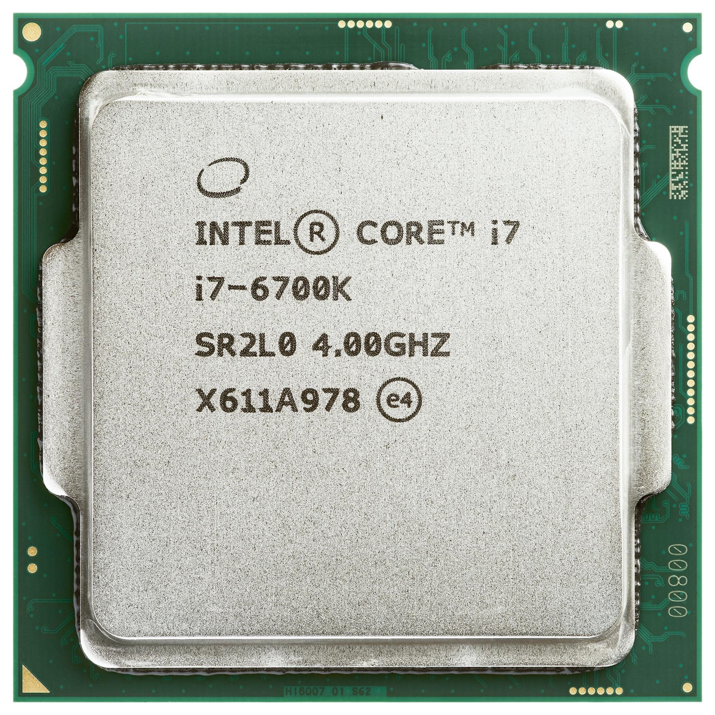
How Realistic are Persistency Races?
Compiler
Architecture
Program Code
(ARM64)
LLVM-clang
(X86-64)
Notes:
Another case of persistency race is a common optimization by both LLVM and C++ for both ARM and X86 platforms where …

Slide 17
How Realistic are Persistency Races?
Compiler
Architecture
Replacing a sequence of assignments with:
Program Code
memset
memcpy
memmove
(ARM64)
LLVM-clang
(X86-64)
Notes:
… The compilers replace a sequence of assignment to contiguous fields, with LIBC memory functions such as memset, memcpy and memmove. These functions do not guarantee 64-bit atomicity and consequently…

Slide 18
How Realistic are Persistency Races?
Compiler
Architecture
Replacing a sequence of assignments with:
Program Code
memset
memcpy
memmove
(ARM64)
Persistency Race
LLVM-clang
(X86-64)
Notes:
This set of optimization may result in store tearing leading to persistency races.

Slide 19
How Realistic are Persistency Races?
These optimizations are common
Benchmark | # writes replaced with mem ops
CCEH | 27
Fast Fair | 2
RECIPE | 22
struct Test {
int x1;
int x2;
};
struct Test var;
var.x1 = 0;
var.x2 = 0;
Assembly Code
lea rax, [rbp-8]
mov edx, 8
mov esi, 0
mov rdi, rax
call memset
Notes:
We investigated the source code and the generated binary for CCEH and Fast Fair and 4 benchmarks of RECIPE and we realized there are 27, 2, and 22 cases where a normal write in the source code is replaced by memory operation in the binary.
This study shows this optimization is actually very common in practice.
Although, the store tearing could be prevented at low cost by changing the specification of these operations. However, …

Slide 20
How Realistic are Persistency Races?
These optimizations are common
Changing the standards is not trivial
Benchmark | # writes replaced with mem ops
CCEH | 27
Fast Fair | 2
RECIPE | 22
struct Test {
int x1;
int x2;
};
struct Test var;
var.x1 = 0;
var.x2 = 0;
Assembly Code
lea rax, [rbp-8]
mov edx, 8
mov esi, 0
mov rdi, rax
call memset
Notes:
… These operations are part of the c++ standards and it’s not trivial to change the standard specifications. It’s a time consuming task and at the end, it is possible that the standard writers decide not to change it since the language already provides a correct way of avoiding it, which would be using atomics.

Slide 21
Yashme Overview
Instrumented Binary
PM Program
First tool to find persistency races
Built on top of Jaaru
Compile
LLVM Frontend
Crash Insertion
Jaaru
Scheduler
Runtime System
Bug
Report
Yes
No
More
Executions?
Yashme
Notes:
We designed and implemented a new tool called Yashme to detect persistency races in the program.
Yashme is implemented on top of Jaaru which is a model checking engine to run programs and simulate crashes in them.
To use Yashme, the program has to be compiled with the LLVM frontend which instruments all memory accesses, cache and fence instructions in the program. Then, after executing the binary file, …

Slide 22
Yashme Overview
Instrumented Binary
PM Program
First tool to find persistency races
Built on top of Jaaru
Random vs. model checking mode
Compile
LLVM Frontend
Crash Insertion
Jaaru
Scheduler
Runtime System
Bug
Report
Yes
No
More
Executions?
Yashme
Notes:
Yashme controls Jaaru’s scheduler and picks an interleaving and a target crash point.
Then, the runtime system runs the program, and simulates the target crash, and reruns the program to recover from it.
Yashme monitors both pre-crash and post-crash executions to determine which stores may be partially persisted.
This process repeats until there are no more new executions in model-checking mode, or reach the maximum execution limit in random mode.
At the end, Yashme reports all persistency races found the program.

Slide 23
Yashme Basic Approach
Ensuring stores are fully persistent
Pre-crash Code
Post-crash Code
x = 0xAAAA
flush(&x)
z.store(2)
>>> Crash
4. flush(&z)
R1 = z.load()
// z = 2
2. R2 = x
Initially x=0 and z=0
They are in different cache lines
Notes:
Yashme’s basic approach is to rely on cache coherency and clflush to ensure that non-atomic stores are fully persistent. Let’s look at the following example to present these approaches in Yashme.
On the left, the pre-crash execution writes to X and flushes that variable. Then, it writes to an atomic variable Z and the program crashes before flushing this variable. X and Z are initialized to 0 at the beginning, and they are located on different cache lines. The post-crash execution first loads value of 2 for Z and then reads from variable X.

Slide 24
Yashme Basic Approach
Ensuring stores are fully persistent
Execution flushes the cache line after the store and before the crash
Pre-crash Code
Post-crash Code
HB
x = 0xAAAA
flush(&x)
z.store(2)
>>> Crash
4. flush(&z)
R1 = z.load()
// z = 2
2. R2 = x
R2 = 0xAAAA
HB
Notes:
For this example, since the pre-crash execution explicitly flushes the cache line after the store, and the flush happens-before the crash event, the store is fully persisted and the post-crash execution will read the value of quadruple AAAA for x.

Slide 25
Yashme Basic Approach
Ensuring stores are fully persistent
Pre-crash Code
Post-crash Code
x = 0xFFFF
y.store(20)
>>> Crash
R1 = y.read()
// y = ??
2. R2 = x
x and y in the same cache line
y is atomic
Initially x = 0xAAAA
Notes:
In addition to flush operations, Yashme relies on cache coherency to ensure a total order in the persistence of stores to the same cache line.
To illustrate the idea, let’s look at another example. On the left, the pre-crash execution stores value of quadruple FFFF to x and writes 20 in variable Y and then, the program crashes. In this example, we assume X and Y are located in the same cache line where y is atomic, and x is a non-atomic variable initialized to quadruple AAAA. The post-crash execution, …

Slide 26
Yashme Basic Approach
Post-crash execution reads from a later atomic store to the same cache line
Ensuring stores are fully persistent
Pre-crash Code
Post-crash Code
x = 0xFFFF
y.store(20)
>>> Crash
R1 = y.read()
// y = 20
2. R2 = x
x and y in the same cache line
y is atomic
Initially x = 0xAAAA
Notes:
.. Reads value 20 for Y. Since X and Y are on the same cache line, cache coherency guarantees the store to X, the first instruction, is completely written to the cache line before the store to y, even if store to X is torn into multiple stores. Since the post-crash execution observes the store to y, the cache line is flushed sometime after instruction 2.
So, since the post-crash execution reads from a later atomic store to the same cache line, …

Slide 27
Yashme Basic Approach
Post-crash execution reads from a later atomic store to the same cache line
Ensuring stores are fully persistent
Pre-crash Code
Post-crash Code
x = 0xFFFF
y.store(20)
>>> Crash
R1 = y.read()
// y = 20
2. R2 = x
x and y in the same cache line
R2 = 0xFFFF
Notes:
… the store to x is fully persistent and the post-crash reads FFFF for x.

Slide 28
Yashme Key Idea
Observing Persistency Race:
Post-crash Code
R1 = x
// R1 = 0xFFFF
x=0xFFFF
flush(&x)
Pre-crash Code
Crash
Pre-crash execution
x = 0xAAAA
flush(&x)
x = 0xFFFF
flush(&x)
>>> Crash
Window for detecting persistency race
Notes:
The main challenge with these basic approaches is that detecting persistency races requires the crash to fall into a small window of execution after the store, and before the cache line flush.
In this example, since the crash is simulated outside of the detection window, no partially persisted value is observed by the post-crash execution with basic approaches. However,

Slide 29
Yashme Key Idea
Observing Persistency Race:
Program must crash between store and clflush
Post-crash Code
Persistency Race
R1 = x
// R1 = 0xFFAA
x=0xFFFF
flush(&x)
Pre-crash Code
Crash
Pre-crash execution
x = 0xAAAA
flush(&x)
x = 0xFFFF
>>> Crash
4. flush(&x)
Window for detecting persistency race
Notes:
If the crash was simulated inside of the detection window, the post-crash execution could observe partially persisted value of FFAA in variable X and report a persistency race for this variable.

Slide 30
Yashme Key Idea
Observing Persistency Race:
Program must crash between store and clflush
It’s expensive to inject crashes in an large number of executions
x=0xFFFF
flush(&x)
Pre-crash Code
Crash
Pre-crash execution
x = 0xAAAA
flush(&x)
x = 0xFFFF
>>> Crash
4. flush(&x)
Window for detecting persistency race
Notes:
This requirement dictates aggressively injecting crash events in a great number of executions and exhaustively exploring thread schedules.

Slide 31
Yashme Key Idea
Expanding the Detection Window:
Consistent prefix of pre-crash must contain any statement which happens before a pre-crash store read by post-crash
Detecting persistency races in derived executions without actually running them
Derived Execution
Derived Execution
Derived Execution
Derived Execution
Pre-crash execution
Derived Execution
Derived Execution
Derived Executions
Notes:
The key idea in Yashme is to expand the existing detection window to make more races observable.
In other words, Yashme does not rely on perfectly timed crash events to trigger races; instead, given a target crash event, it derives executions that share a prefix with the pre-crash execution, up to and including all stores that the post-crash execution read from.
This expansion technique enables Yashme to detect races in derived executions without the need to actually execute them.
The idea is that when the pre-crash execution has flushed a store instruction, but the post-crash execution has not read from any stores after the flush, we can ignore the flush operation to find persistency races in the execution that we are not currently exploring.
To demonstrate the idea,

Slide 32
Yashme Key Idea
Expanding the Detection Window:
x=0xAAAA
flush(&x)
y.store(20)
Crash
Pre-crash execution
Consistent crash interval
Pre-crash Code
Post-crash Code
x = 0xAAAA
flush(&x)
y.store(20)
>>> Crash
R1 = x
// R1 = ???
2. R2 = y.read()
// R2 = ???
Notes:
…let’s take a look at an example. On the left, the pre-crash execution writes to X and flushes the variable and do an atomic write to Y and then, the program crashes. On the right, the post-crash execution reads from variable x and y. In the middle you can see the timeline for pre-crash operations.
The red arrow shows the constraint of crash interval that is consistent with the stores read by the post-crash execution.
This constraint shows the range of places that crash could have happened in the pre-crash execution.

Slide 33
Yashme Key Idea
Expanding the Detection Window:
x=0xAAAA
flush(&x)
y.store(20)
Crash
Pre-crash execution
Consistent crash interval
Pre-crash Code
>>> Crash
x = 0xAAAA
>>> Crash
Post-crash Code
x = 0xAAAA
flush(&x)
y.store(20)
>>> Crash
R1 = x
// R1 = ???
2. R2 = y.read()
// R2 = ???
x = 0xAAAA
flush(&x)
>>> Crash
x = 0xAAAA
flush(&x)
y.store(20)
>>> Crash
Derived executions
Notes:
Initially, the post-crash execution did not read from any stores. So, the crash interval includes all operations in the pre-crash execution, which means Yashme derives 4 executions from the pre-crash execution where the crash could have happened before instruction 1, after instruction 1, after instruction 2, and after instruction 3.

Slide 34
Yashme Key Idea
Yashme determine there is a prefix of pre-crash execution that doesn’t execute the flush(X)
Expanding the Detection Window:
x=0xAAAA
flush(&x)
y.store(20)
Crash
Pre-crash execution
Consistent crash interval
x = 0xAAAA
>>> Crash
Pre-crash Code
Post-crash Code
x = 0xAAAA
flush(&x)
y.store(20)
>>> Crash
R1 = x
// R1 = 0xAAAA
2. R2 = y.read()
// R2 = ???
x = 0xAAAA
flush(&x)
>>> Crash
x = 0xAAAA
flush(&x)
y.store(20)
>>> Crash
Derived executions
Notes:
By executing the post-crash code, after reading the value of quadruple AAAA for X, Yashme updates the crash interval where crash has happened after execution of instruction 1.
Yashme infers that one of the the derived executions does not execute the flush. Therefore, …

Slide 35
Yashme Key Idea
Persistency Race on X
Expanding the Detection Window:
x=0xAAAA
flush(&x)
y.store(20)
Crash
Pre-crash execution
Consistent crash interval
x = 0xAAAA
>>> Crash
Pre-crash Code
Post-crash Code
x = 0xAAAA
flush(&x)
y.store(20)
>>> Crash
R1 = x
// R1 = 0xAAAA
2. R2 = y.read()
// R2 = ???
x = 0xAAAA
flush(&x)
>>> Crash
x = 0xAAAA
flush(&x)
y.store(20)
>>> Crash
Derived executions
Notes:
… Yashme reports persistency race on reading from variable X without actually exploring this derived execution.

Slide 36
Yashme Key Idea
Expanding the Detection Window:
x=0xAAAA
flush(&x)
y.store(20)
Crash
Pre-crash execution
Consistent crash interval
Pre-crash Code
Post-crash Code
x = 0xAAAA
flush(&x)
y.store(20)
>>> Crash
R1 = x
// R1 = 0xAAAA
2. R2 = y.read()
// R2 = 20
x = 0xAAAA
flush(&x)
y.store(20)
>>> Crash
Derived executions
Notes:
As the post-crash execution progresses and reads from more writes, Yashme updates the constraint for crash interval, to be consistent with the post-crash execution, and looks for more persistency races with the updated constraint.

Slide 37
Fix Persistency Race
Use atomic store instead of non-atomic store!
Pre-crash Code
x = 0xFFFF;
flush(&x);
x.store (0xFFFF)
Notes:
Fixing persistency races is very simple. The developers only need to replace problematic non-atomic stores with atomic stores, so compiler avoids performing any optimizations on them leading to values becoming partially persisted.

Slide 38
Evaluation
Evaluated Yashme on a collection of data structure for persistent memory
Persistent B+Tree, DRAM indexes, etc.
Yashme found 19 persistency races in FAST FAIR, CCEH, and RECIPE benchmarks
Notes:
We evaluated Yashme on Fast Fair, CCEH, and four RECIPE benchmarks. These benchmarks are a collection of data structure such as B+Tree and different DRAM Indexes for persistent memory. In total, Yashme found 19 persistency races in these benchmarks.

Slide 39
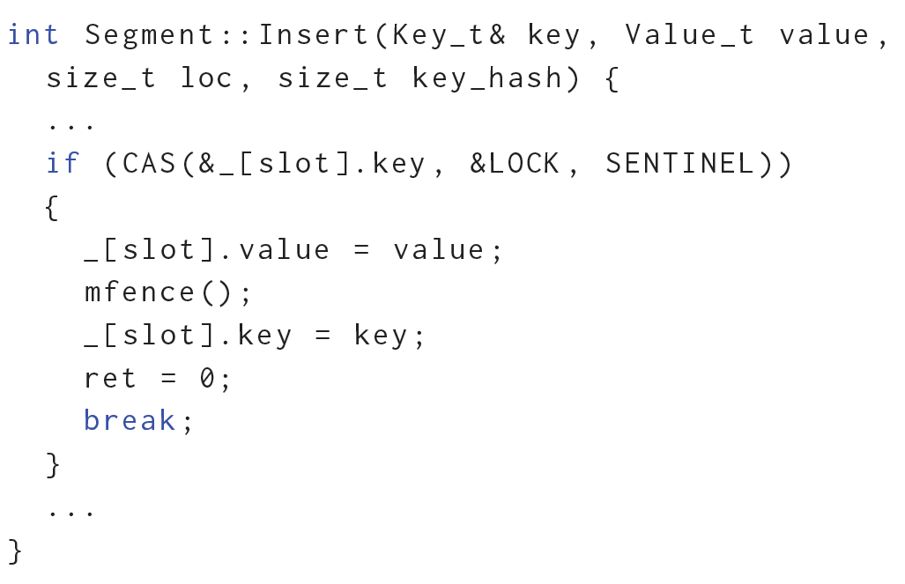
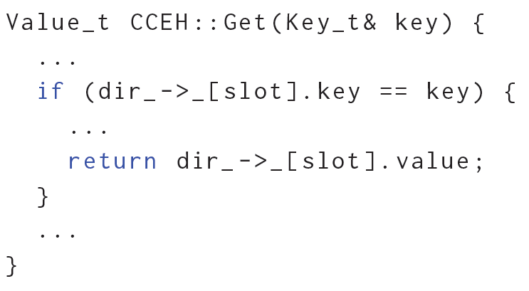
Evaluation
Example of real persistency race in CCEH
Pre-crash execution
Post-crash execution
Notes:
Here you can see one example of persistency races that Yashme found in CCEH.
On the left in insert function, if the pre-crash execution could write SENTINEL value to the key of the given slot, then it updates its corresponding value and key with proper values.
On the right in get function, the post-crash execution looks up for a key and if it matches with the key of any slots it returns the corresponding value.

Slide 40
Evaluation
Example of real persistency race in CCEH
Pre-crash execution
Post-crash execution
Data inconsistency in the data structure
Notes:
This code suffers from persistency races since key and value aren’t atomic, and key can be partially persisted due to a poorly-timed crash.
This can lead to data inconsistency in the data structure, and the post-crash can accidentally read from a key that never be inserted to the data structure and return wrong value.

Slide 41
Evaluation
Evaluated Yashme on real-world frameworks:
PMDK: library for accessing persistent memory
Redis: in-memory database and memory cache
Memcached: high-performance distributed memory caching system
Yashme found 5 persistency races in these frameworks
Notes:
In addition, we evaluated Yashme on a set of real-world frameworks such as PMDK which is a popular library for accessing persistent memory, Redis which is a well-known in-memory database and memory cache, and Memcached which is a high-performance distributed memory caching system ported to use persistent memory.
We found 5 persistency races in these frameworks.

Slide 42
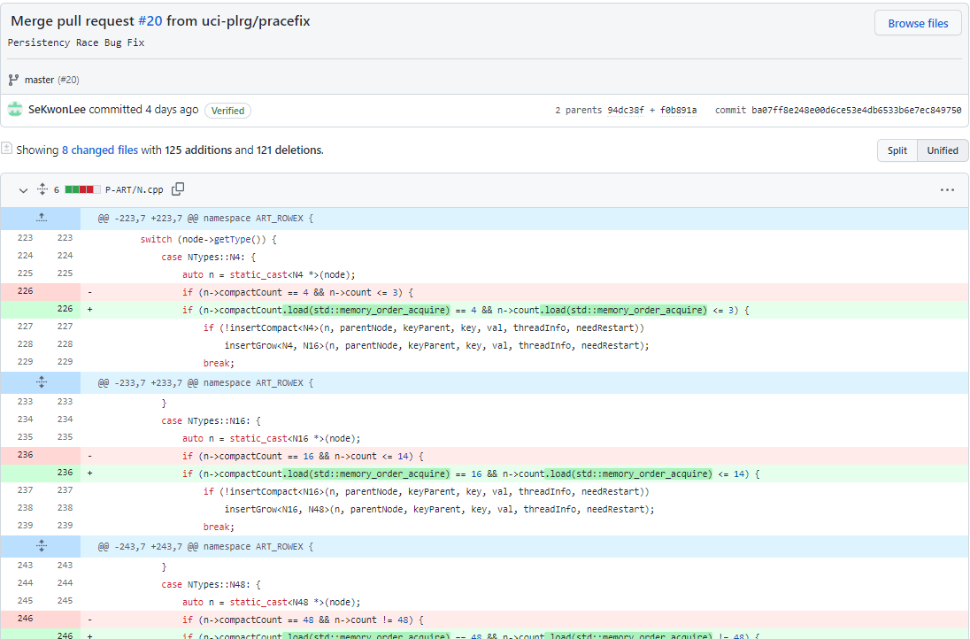
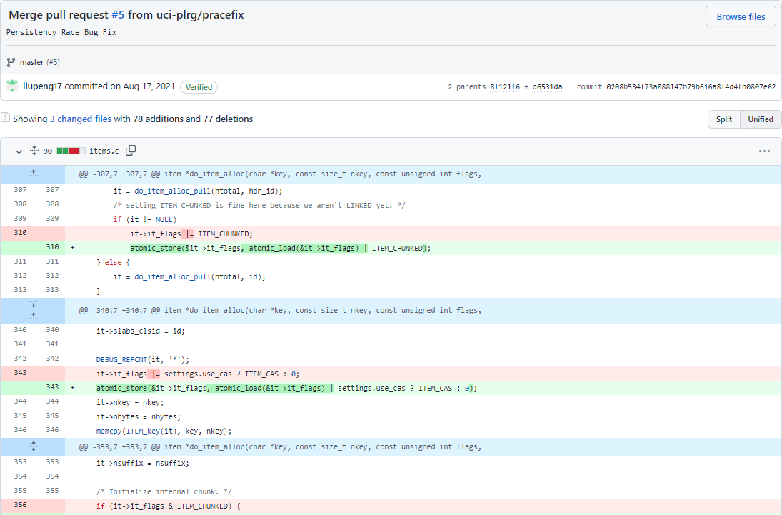
Evaluation
Reported bugs are fixed in the original Github repositories.
Notes:
We reported persistency races found by Yashme to the developers of these tools.
Most of these persistency races are confirmed by the developers, and the corresponding fixes are publicly available in the github repository of these frameworks.

Slide 43
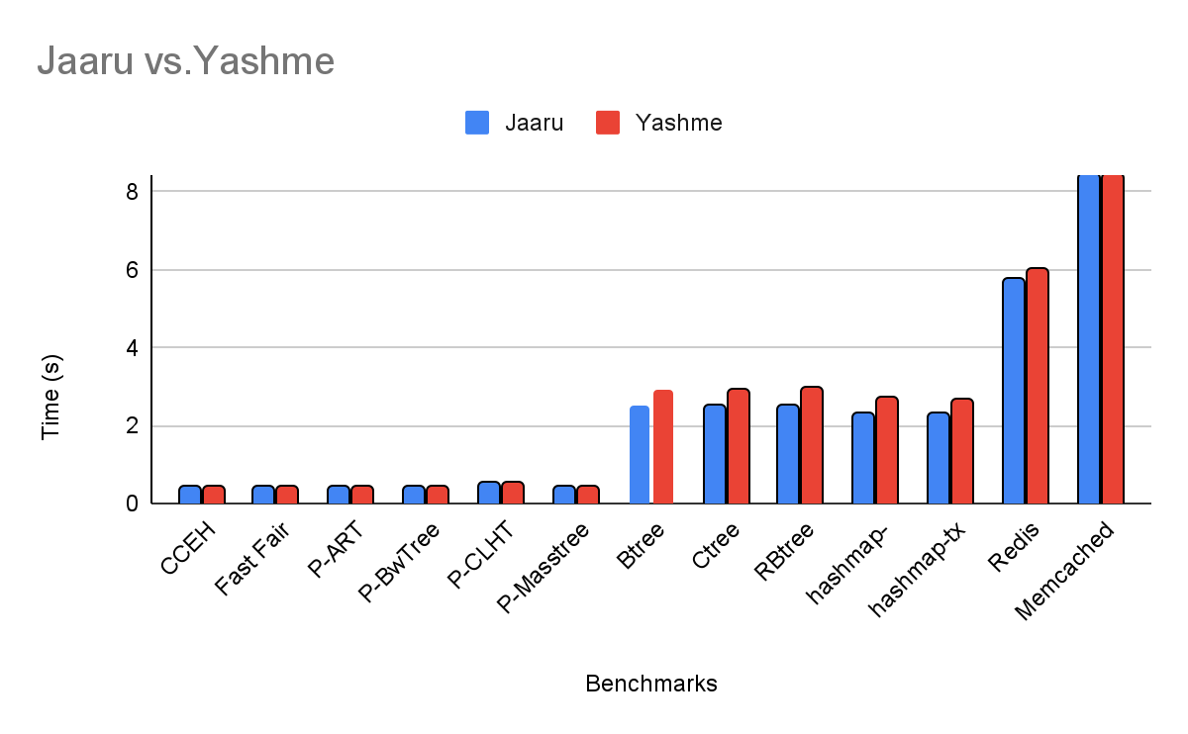
Evaluation
Negligible overhead compared to Jaaru, the underlying model checker
Notes:
For each of these benchmarks, we compared the execution time of Yashme with Jaaru, the underlying infrastructure.
In this figure, the Y axis represents time in seconds and X axis shows the names of the benchmarks. The blue and red bars represent the execution time of Jaaru and Yashme.
As it can be seen, Jaaru and Yashme have comparable running times because the race checks introduce minimal overheads.

Slide 44
Conclusion
Testing persistent memory program is difficult, and compilers optimizations adds even more complexities!
Yashme
First tool to detect persistency races
Uses a technique to be scalable to larger programs
Found 24 persistency races in various persistent memory applications and libraries with negligible overhead.
Available on: plrg.ics.uci.edu/yashme
Notes:
To conclude my talk, testing a persistent memory program is difficult and compiler optimizations make it even more complicated.
As a solution, we presented Yashme, the first tool to detect a new class of persistency bugs, which we call it persistency race.
Yashme uses a novel approach to find persistency races in executions without actually exploring them.
We evaluated Yashme on real-world frameworks and a collection of data structures, and it found 24 persistency races in these frameworks with negligible overhead.
Yashme is open-source and it is publicly available at the link provided in this slide.

