Slide 1
ASAP: A Speculative Approach to Persistence
Sujay Yadalam, Nisarg Shah, Xiangyao Yu, Mike Swift
{sujayyadalam, nisargs, yxy, swift}@cs.wisc.edu
University of Wisconsin-Madison

Slide 2
Executive summary
Recoverable applications that use Persistent Memory (PM) require ordering of writes to memory
Commercially available systems are inefficient
State-of-the-art designs don't scale well in a multi-memory controller system with large number of cross-thread dependencies
Flushing stalled for 1 in 4 cycles on average
ASAP uses eager flushing and speculative updates to efficiently order writes
Achieves performance close (within ~4%) to an ideal system

Slide 3
Outline
Overview
Motivation
Existing designs
ASAP design principles
Results

Slide 4
Persistent memory
Close to DRAM performance
Byte-addressable
High density
Non-volatile
Load/store interface
Hardware encryption
Intel Optane Persistent memory
Persistent memory (PM) enables recoverable applications with in-memory data structures
Notes:
Preserve application progress across reboots and failures.

Slide 5
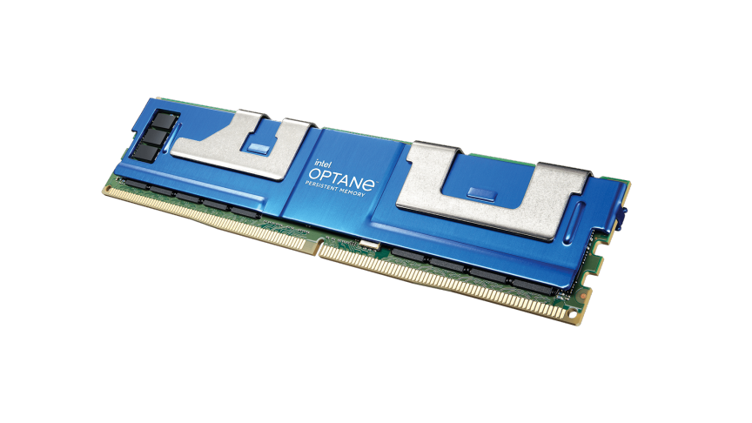
Recovery requirements
Recoverability imposes order on writes to PM
Problem: cache hierarchy could re-order writes
Core
*food
fish
Cache
Crash
Writeback
For correct recovery, data should be persisted before the pointer
Memory controller
Pointing to incorrect data
fish
*food
onion
Notes:
Recoverability requires a consistent state;
Application developers and hardware need to work together to ensure correct ordering

Slide 6
Flush and Fence
Current systems use flush and fence for ordering
Intel x86 systems: CLWB and SFENCE
Epoch: group of unordered writes;
epochs ordered using fence.
E₁:
E₂:
E₁ needs to be persisted before E2
Objective: Persist Data before Pointer
…
MOV a, 0x1234
MOV fish, 0xABCD
CLWB fish
SFENCE
MOV *food, Addr(fish)
fish
a
Timeline
*food
fish
*food
a
Enforcing order causes stalls. Degrades performance.
1
FENCE
2

Slide 7
Buffered Persistency
HOPS¹ (ASPLOS ‘17), DPO² (MICRO ‘16)
Buffer writes in a hardware queue, track ordering
Write them out lazily in-order
fish
Persist path
Core
Cache
Persist Buffer
Memory controller
Decouples persistence from core execution
Ordering without stalling frequently
[1] S. Nalli et.al., “An analysis of persistent memory use with whisper,” in ASPLOS 2017.
[2] A. Kolli et.al., “Delegated persist ordering,” in MICRO 2016

Slide 8
1) Ordering across memory controllers
Order:
fish
*food
Correct recovery requires ordering across controllers
Existing solutions use conservative flushing
Writes to MC2 not flushed till writes to MC1 completes
Core
(does not flush till ACK from MC1)
Cache
*food
fish
ACK
Memory controller 1
Memory controller 2
Conservative flushing leads to under-utilization of available system write bandwidth
Notes:
Cannot overlap writes to multiple memory controllers if separated by fence

Slide 9
2) Cross-thread ordering
Order:
A
B
Cross-thread dependencies could arise
Access to same address by 2 or more threads
Synchronization between threads
Like before, existing solutions use conservative flushing
Dependent thread stalls flushing till source thread completes its writes
Core 1
Core 2
Does not flush till core 1 finishes
E
D
Cache
Cache
C
A
B
PB
PB
Memory controller
Conservative flushing causes flushing stalls
Frequent flushing stalls fill up the buffers, exert back pressure on the cores by stalling them
Notes:
Reduce time here;

Slide 10
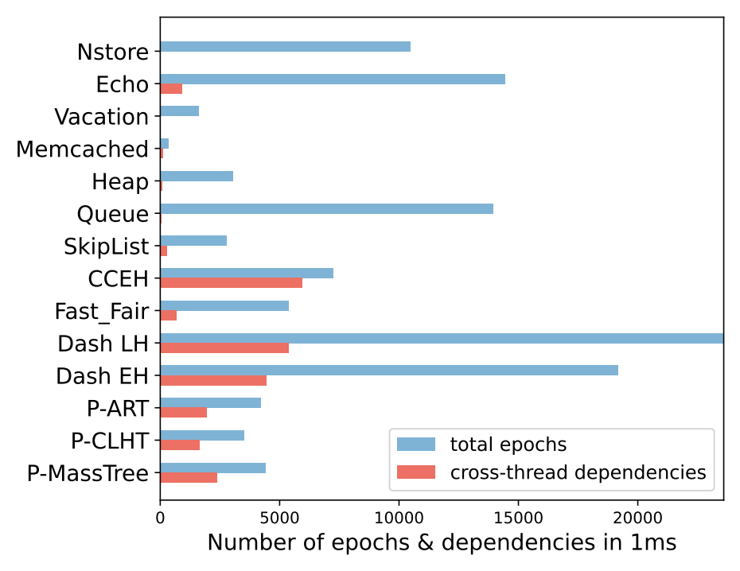
Cross-thread ordering
Cross-thread dependencies could arise
Access to same address by 2 or more threads
Synchronization between threads
Like before, existing solutions use conservative flushing
Dependent thread stalls flushing till source thread completes its writes
Cross-thread dependencies are frequent
Conservative flushing causes flushing stalls
Frequent flushing stalls fill up the buffers, exert back pressure on the cores by stalling them
Notes:
Explain figure in more detail;

Slide 11
ASAP overview
Goals: 1) Utilize system write bandwidth efficiently
2) Avoid flushing stalls
Crashes are rare, so ASAP takes an optimistic approach:
Flush writes eagerly and possibly out-of-order
Speculatively update memory with “early” writes
Maintain recovery information to revert changes in case of crashes
Key insight: Intel ADR* feature allows some data in memory controller queues to be persisted after power failure; can use ADR to store fix-up information
* ADR = Asynchronous DRAM refresh
Notes:
Say ADR is a feature in today’s systems

Slide 12
Eager flushing
Persist buffers in ASAP flush writes as soon as they arrive
Doesn’t stall waiting for previous epochs to complete
Flushes are marked ‘safe’ or ‘early’
Ordering
Currently flushing
T0
E_{0,0}
E_{0,1}
E_{0,2}
E_{0,0}
E_{0,1}
Waiting
Completed
T1
E_{1,0}
E_{1,2}
E_{1,0}
E_{1,1}
E_{1,1}
Conservative Flushing
Core
T0
E_{0,2}
E_{0,0}
E_{0,1}
E_{0,2}
E_{0,1}
T1
E_{1,2}
E_{1,0}
E_{1,1}
E_{1,2}
Persist
Buffer
Cache
E_{1,1}
Eager Flushing
Notes:
Color consistency;
Maybe leave out ET here

Slide 13
Tagging ‘early’ flushes
Epoch Tables (ET) stores epoch metadata
Tracks ordering dependencies between epochs
Including dependencies across threads
ET determines if a flush is ‘safe’ or ‘early’
safe if previous epochs complete
early if previous epochs are still flushing
Core
Persist
Buffer
L$
ET
Epoch Table
TS
Pending Ack
Src
ThreadID
Src TS
Dependent
ThreadID
MC
bit vec
32b
5b
8b
32b
8b
16b
Notes:
Figure in the same place;
Relation between safe and conservative flushing

Slide 14
Handling early flushes
B
(early)
Memory controllers in ASAP also take an optimistic approach
On receiving ‘early’ flush, tries to update memory speculatively
Read old value from memory before updating
Create undo record using the old value
Store these records in recovery table (RT) backed by ADR
Shared LLC
Recovery Table
MC
DRAM
PM
B

Slide 15
Freeing space in RT
ET sends commit message to memory controllers after
After all flushes in an epoch complete AND
Dependencies are resolved
Memory controllers delete undo records belonging to that epoch
Core 1
Core 2
Cache
Cache
ET
ET
PB
PB
Memory controller
Epoch
commit
RT

Slide 16
ASAP in action
Order:
A
B
Epoch complete
Core 1
Core 2
Cache
Cache
A
(early)
PB
B
ET
PB
commit
ACK
Memory controller
Undo record:
B = old value
RT
Read value of B

Slide 17
Write collisions
Undo logs are insufficient when multiple threads write to same address
Core 1
Core 2
Core 3
ASAP handles such collisions by creating delay records
Delay records are stored in the recovery tables
They are written out later (or discarded) when epoch commit is received
A=1
Cache
A=2
Cache
Cache
A=3
ET
PB
ET
PB
PB
ET
Memory controller
Order:
Undo A=0
A=1
A=2
A=3
Redo A=2
A=0

Slide 18
Outline
Overview
Motivation
Existing designs
ASAP design principles
Results

Slide 19
Evaluation setup
gem5 full system simulations
System config:
4 CPU cores based on Intel Xeon processors
2 memory controllers
PM characteristics modelled using real world experiments
Workloads:
WHISPER¹ benchmark suite
Custom data-structures using ATLAS framework
Data structures designed for PM (CCEH, RECIPE)
[1] S. Nalli et.al., “An analysis of persistent memory use with whisper,” in ASPLOS 2017.
Notes:
We aimed to study the performance benefits of eager flushing. We ran experiments to understand how well ASAP performs compared to existing solutions that use conservative flushing. We were also interested in determining how close ASAP was to an ideal system.

Slide 20
Performance comparison
Notes:
Explain what is baseline; no PBs, go through caches;
Speedup “normalized”

Slide 21
Performance comparison

Slide 22
Performance comparison
ASAP improves performance by ~23% on average
Large number of cross-thread dependencies

Slide 23
Performance comparison
ASAP performance close to ideal (within ~4%)
Notes:
What is an ideal system? No overhead of ordering and persistence, flushing cost, immediate persistence

Slide 24
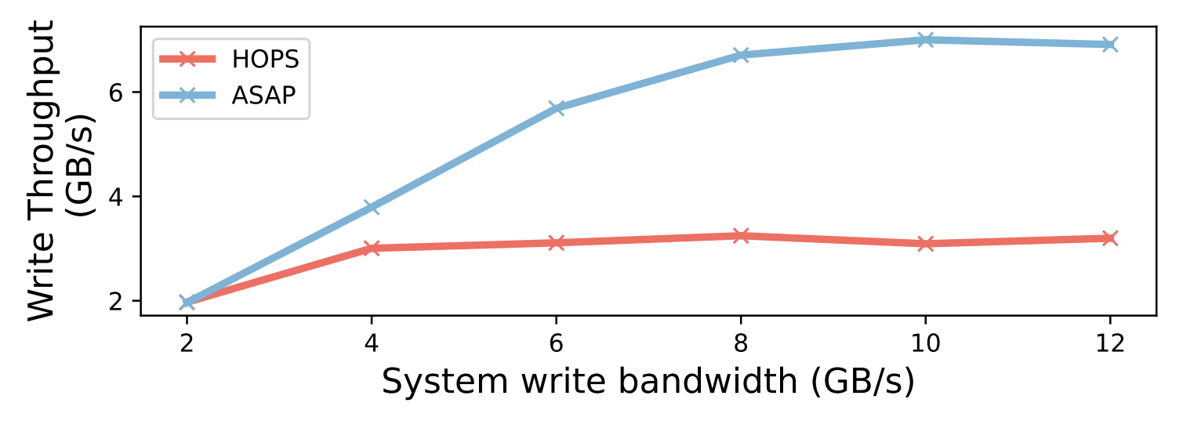
Bandwidth utilization
Micro-benchmark: Alternating writes to 2 memory controllers separated by a fence
ASAP improves bandwidth utilization by 2x
HOPS unable to flush writes to both memory controllers simultaneously
while i < n:
MC1 = rand_val();
FENCE
MC2 = rand_val();
Notes:
For more results such as how ASAP scales with more cores; and effect of eager flushing on buffer occupancies and write amplification, please read our paper.

Slide 25
Conclusion
Recoverable applications using PM require correct ordering of writes
State-of-the-art designs are not efficient at
Ordering across memory controllers
Ordering across threads
ASAP uses an optimistic approach:
Flushes writes eagerly
Updates memory speculatively while maintaining some fix-up info in case of crashes
ASAP improves performance over existing solutions by ~23% and within 4% of an ideal system

Slide 26
ASAP: A Speculative Approach to Persistence
Sujay Yadalam, Nisarg Shah, Xiangyao Yu, Mike Swift
sujayyadalam@cs.wisc.edu
https://github.com/multifacet/ASAP
University of Wisconsin-Madison

Slide 27
Crash recovery
Order:
A
B
During a crash, ADR lets undo records in the recovery tables (RT) to be written out to memory
Core 1
Core 2
Cache
Cache
ET
ET
PB
PB
A
Memory controller
B’s old value
Crash
RT
Consistent state
B

Slide 28
ASAP system overview
Core
Core
Core
Core
PB
PB
PB
Persist
Buffer
Cache
Cache
Cache
Cache
ET
ET
ET
Epoch Table
3
Shared LLC
2
1
Recovery Table
1
Persist path
MC
MC
2
Epoch commit
3
Epoch completion
DRAM
PM
DRAM
PM

Slide 29
Flush and Fence
Current systems use flush and fence for ordering
Intel x86 systems: CLWB and SFENCE
Objective: Persist Data before Pointer
MOV Data, 0x007
CLWB Data
SFENCE
MOV Pointer, Addr(Data)
*p
FENCE
data
2
1
Enforcing order causes stalls. Degrades performance.

Slide 30
ASAP overview
Goals: 1) Utilize system write bandwidth efficiently
2) Avoid flushing stalls
Crashes are rare, so ASAP takes an optimistic approach:
Flush writes eagerly and possibly out-of-order
Speculatively update memory with “early” writes
Maintain recovery information to revert changes in case of crashes
Key insight: Intel ADR allows some data in memory controller queues to be persisted after power failure; can use ADR to store fix-up information

Slide 31
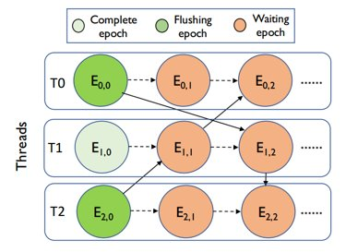
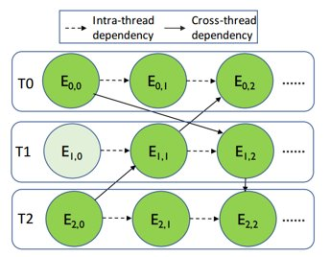
Eager flushing
Avoids flushing stalls and
Utilizes system write bandwidth efficiently
Conservative flushing
Eager flushing

Slide 32
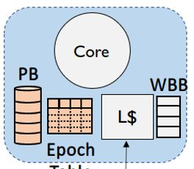
Persist buffers
Per-core volatile circular buffers
Writes to PM enqueued in PBs
Writes tagged with timestamp (TS) to track order
Writes flushed eagerly
Flushes labelled ‘safe’ or ‘early’
Epoch Tables helps in labelling

Slide 33
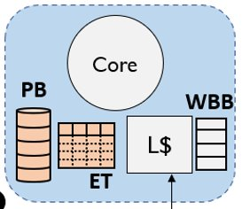
Epoch tables
Per-core volatile buffers
Stores metadata of in-flight epochs
Uses coherence to detect cross-thread dependencies
Notifies other cores and memory controllers of epoch completions

Slide 34
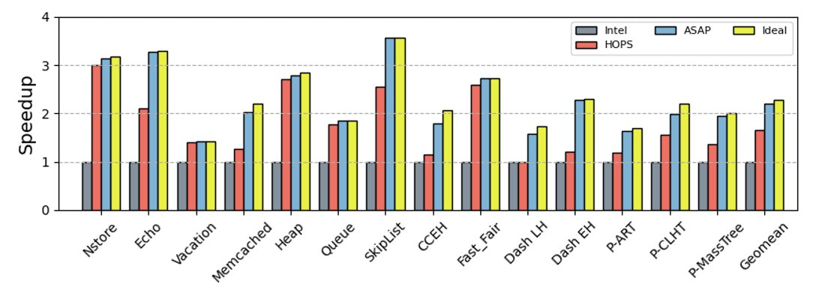
Performance study

Slide 35
Recovery Tables
Buffers in the memory controllers
Belong to persistent domain, backed by ADR
Stores recovery information: undo records and delay records
On receiving an ‘early’ flush, memory controller
Reads old value from memory to create undo record
Updates memory specualtively

