Slide 1

A definitive demonstration that resistance-switching memories are not memristors
Jinsun Kim
Department of Physics and
Astronomy
University of South Carolina
Columbia, South Carolina 29208
Yuriy V. Pershin
Department of Physics and
Astronomy
University of South Carolina
Columbia, South Carolina 29208
Ming Yin
Physics/Engineering
Department
Benedict College
Columbia, South Carolina 29204
Timir Datta
Department of Physics and
Astronomy
University of South Carolina
Columbia, South Carolina 29208
Massimiliano Di Ventra
Department of Physics
University of California, San Diego,
La Jolla, California 92093
Presenter: Jinsun Kim
Notes:
Hello everyone, my name is Jinsun Kim
and I am from University of South Carolina.
The title of my talk today is a definitive demonstration
that resistance switching memories are not memristors.

Slide 2
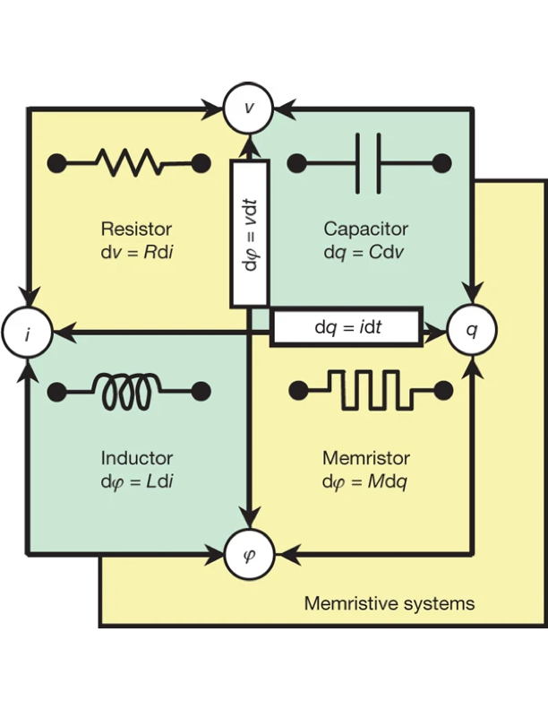
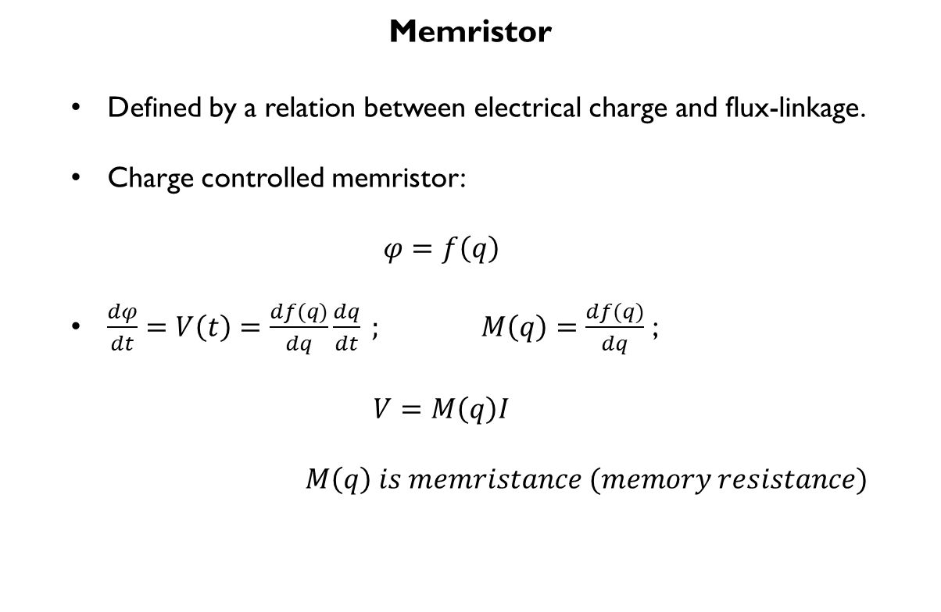
memristor
Memristor
  Defined by a relation between electrical charge and flux-linkage.
  Charge controlled memristor:
  $$φ=f\left(q\right)$$
  $\frac{dφ}{dt}=V\left(t\right)=\frac{df(q)}{dq}\frac{dq}{dt} ;$ $M\left(q\right)=\frac{df(q)}{dq}$ ;
  $$V=M\left(q\right)I$$
  $M\left(q\right) is memristance (memory resistance)$
L. Chua, “Memristor-the missing circuit element,” IEEE Transactions on circuit theory, vol. 18, no. 5, pp. 507–519, 1971.
Notes:
To begin with, let me introduce the definition of the memristor.
In early 1970, Dr. Chua noticed that there are six possible relationships
among four fundamental circuit variables, current, voltage, charge, and flux.
The relationship between the current and voltage can be defined by the resistor, voltage and charge by the capacitor, and current and flux by the inductor.
And also, charge is a time integral of current and the flux is a time integral of voltage.
Then there had been one missing connection between the electrical charge and magnetic flux.
He named the device defined by the relationship between the charge and flux as a memristor. (click)
The functional relationship between the charge and flux can be re-rewritten as an Ohm’s law.
Importantly, in this Ohm’s law, the resistance is a function of charge, or called memristance. Chua also realized that the memristor has a non-volatile memory.

Slide 3
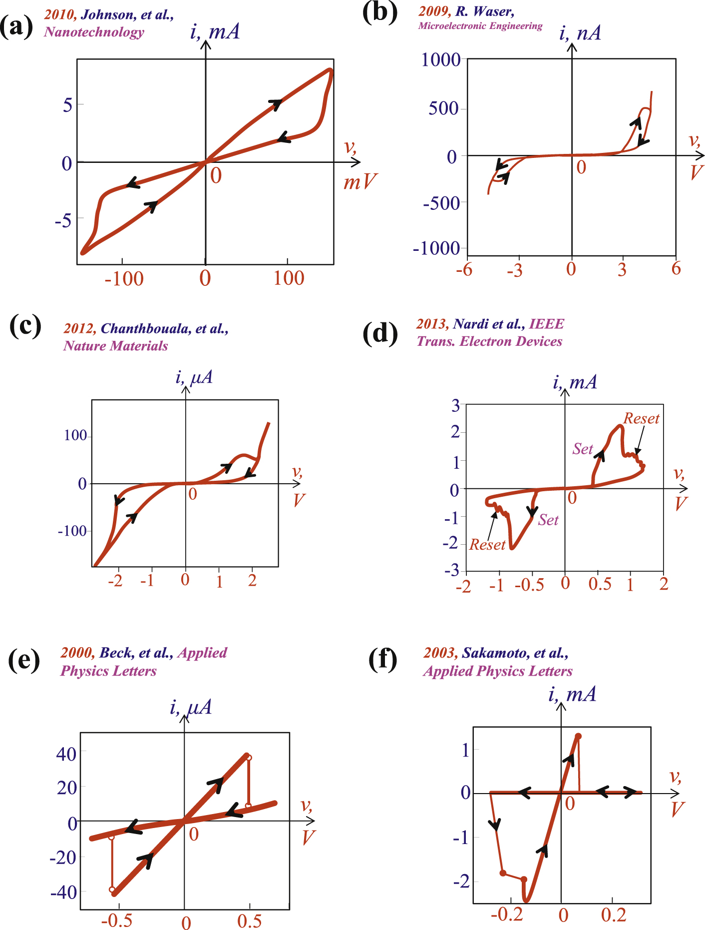
“If it is pinched, it is a memristor.”
Are all resistance switching memories with pinched hyteresis loops memristors?
Chua, Leon. "If it’s pinched it’s a memristor." Semiconductor Science and Technology 29.10 (2014): 104001.
Strukov, D., Snider, G., Stewart, D. et al. The missing memristor found. Nature 453, 80–83 (2008). https://doi.org/10.1038/nature06932
Vongehr, S., Meng, X. The Missing Memristor has Not been Found. Sci Rep 5, 11657 (2015). https://doi.org/10.1038/srep11657
Notes:
Moreover, Dr. Chua claimed that all resistive switching memories
with pinched hysteresis loops in their current-voltage characteristics
are memristors.
The figures on the right side are the examples of pinched but also twisted hysteresis loops from the solid state memristors given by Chua from his literature.
However, this claim is questionable.
Some researchers believe that ideal memristors are found
and the others think they have not been found.

Slide 4
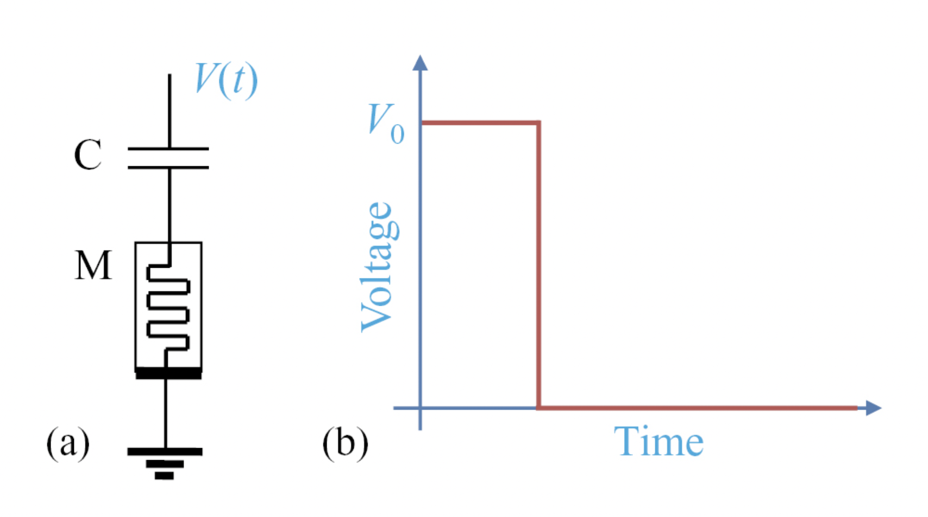
Motivation and memristor test
Suggested test for ideal memristors.
Using duality property of a capacitor-memristor circuit.
Compare the ideal response and experimental response and define if the device is whether ideal memristor or not.
q
M(q)
q_{in}=0
q_{f}=0
M_{in}=M(0)
M_{f}=M(0)=M_{in}
Evolution
Y V Pershin and M Di Ventra 2019 J. Phys. D: Appl. Phys. 52 01LT01
Notes:
To solve this question, Dr. Pershin and Dr. Di Ventra suggested
a simple test for memristors whether the devices are ideal memristors or not.
The point is, if the devices have hysteresis current-voltage behaviors
are memristors,
they also must satisfy the very fundamental mathematical definition: the memristance must be a function of charge.
This is the schematic of the setup circuit, and as you see, (click)
this measurement utilized the duality of capacitor-memristor circuit.
(click) (click) For any initial states of the memristor
and with any form of the applied voltage,
the final state must be identical to its initial state with the charge, zero, when the capacitor charge finally returns to its initial value.
For example, in their study, they used rectangular step function voltage pulse with a wide range of amplitudes.

Slide 5
methodology
Fabricate a device.
Check if the device gives typical I-V characteristics according to the theory claims.
Apply voltage pulse to capacitor-memristor circuit
Compare the ideal response with the experimental response and determine whether device is an ideal memristor or not.
Notes:
Here is our experiment methodology.
First, we fabricate a device.
And then we measure the current-voltage characteristics to check if the device has a typical hysteresis switching as the theory claims.
If it shows the pinched hysteresis loops, it is good to go for a memristor test.
Then we can apply a certain voltage to capacitor-memristor circuit
and eventually, compare the experimental result with the ideal response,
and determine whether device is an ideal memristor or not.

Slide 6








Fabrication of ECM $Cu$-$SiO_{2}$ cell
$$CoCrPt (5 nm)$$
Protection layer
$$Cu (30 nm)$$
Active electrode
$Cu$ metallic filament
$$SiO_{2} (30 nm)$$
Oxide layer
$$Ru (30 nm)$$
Inert electrode
$$Ti (5nm)$$
Adhesion layer
$Si$ substrate
Notes:
In our study, the memristor test was applied to the electrochemical metallization cell, namely ECM cell that is representative of ReRAM devices.
Under the applied bias voltage, active electrode cations migrate through the oxide layer, and they form the metallic filament and connect the active and inert electrodes. (click)
The mechanism of the ECM cell is based on the electrochemical growth and dissolution of this conductive filament in the insulating matrix, depending on the polarity of the applied voltage.
For our study,
We in-house fabricated our own ECM cell, and here is the structure of the device.
On the silicon substrate, titanium is sputtered as an adhesion layer and ruthenium, silicon oxide and copper are stacked as an inert electrode, oxide medium, and an active electrode, respectively.
On the top of the cell, cobalt chromium platinum layer is sputtered to protect the copper electrode from the oxidation.

Slide 7
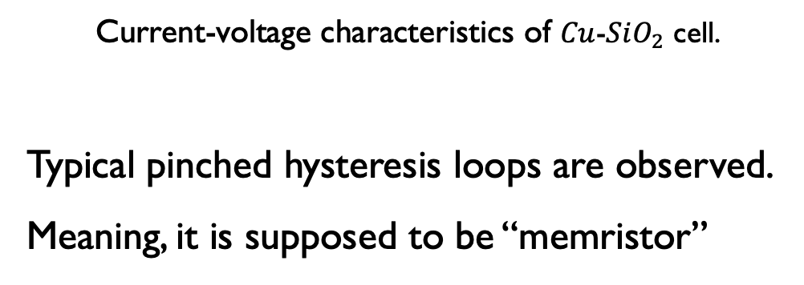
Measurement details: validity of device
Current-voltage characteristics of $Cu$-$SiO_{2}$ cell.
Typical pinched hysteresis loops are observed.
Meaning, it is supposed to be “memristor”
Notes:
Before performing the ideal memristor test, we measured the current-voltage characteristics.
(click) And the results show the typical resistive switching with pinched hysteresis loops. According to Chua, this device is supposed to be an ideal memristor.

Slide 8
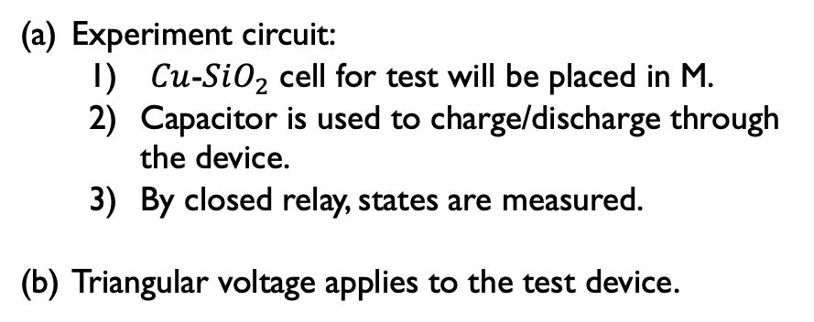
Measurement details: memristor test
(a)
(b)
Experiment circuit:
  $Cu$-$SiO_{2}$ cell for test will be placed in M.
  Capacitor is used to charge/discharge through the device.
  By closed relay, states are measured.
Triangular voltage applies to the test device.
Notes:
After that, We conducted the ideal memristor test using the circuit shown in the slide.
With the relay closed, the capacitor is shunted, and the source measure unit is directly connected to the memristor. This is where the initial resistance is measured.
When the relay is opened, the source measure unit is connected to the capacitor. And the voltage pulse is applied to charge the capacitor and discharge.
In our test, we used a triangular voltage pulse.
Long enough waiting period after the applied pulse is required to unsure the capacitor to be fully discharged.
After the evolution, the final resistance is measured with the closed relay.
For the ideal memristor, with any form of the applied voltage, the initial and final states should be the same after the charge on the capacitor returns to its initial value.

Slide 9


Results and analysis
$$R_{M,i}=53 kΩ$$
$$R_{M,f}=53 kΩ$$
Initial resistance of the device
Applied voltage, V0=0.4V
Final resistance of the device
Memristor test: passed
Notes:
The results from the applied voltage pulse with an amplitude of 0.4V are shown in the figures.
In figure (a), the initial resistance was measured 53 k Ohms, and in figure (b) shows the peak of the current with the triangular pulse. It is observed that it took about 13.5 seconds for the capacitor to discharge. And the figure (c) shows final resistance that is identical to the initial state, 53 k Ohms.
In this case, it passed the memristor test.

Slide 10

Results and analysis
$$R_{M,f}=19.5 kΩ$$
$$R_{M,i}=53 kΩ$$
Initial resistance of the device
Applied voltage, V0=1.0V
Final resistance of the device
Memristor test: NOT passed
Within a particular amplitude of applied voltage, the devices did not show the fundamental behavior of memristors.
Notes:
However, the results of our measurements with the applied voltage pulse with an amplitude of 1.0V do not support the ideal memristor model.
The initial state in the figure (a) shows the resistance 53 k Ohms, but the final resistance is 19.5 k Ohms which differs from the initial state 53 k Ohms. [In this test, the length of triangular pulse was longer, about 26 seconds.]
(click) Consequently, the device did not pass the test.
The test was repeated but the same results were observed.

Slide 11
Conclusion
ReRAM cells are unambiguously NOT memristors.
Future works can apply this memristor test for their devices before they are claimed as memristors.
J. Kim, Y. V. Pershin, M. Yin, T. Datta, and M. Di Ventra, “An experimental proof that resistance-switching memory cells are not memristors,” Advanced Electronic Materials, vol. 6, no. 7, p. 2000010, 2020
Notes:
Therefore, we conclude that the ReRAM devices are not memristors.
Moreover, because of simplicity and affordability of the test, all claimed-to-be memristors should be tested with this suggested method first.
Thanks for your attention. Thank you.

Slide 12
Reference
L. Chua, “Memristor-the missing circuit element,” IEEE Transactions on circuit theory, vol. 18, no. 5, pp. 507–519, 1971.
D. B. Strukov, G. S. Snider, D. R. Stewart, and R. S. Williams, “The missing memristor found,” nature, vol. 453, no. 7191, pp. 80–83, 2008.
Chua, Leon. "If it’s pinched it’s a memristor." Semiconductor Science and Technology 29.10 (2014): 104001.
Vongehr, S., Meng, X. The Missing Memristor has Not been Found. Sci Rep 5, 11657 (2015). https://doi.org/10.1038/srep11657
W. Hu, B. Yang, Y. Zhang, and Y. She, “Recent progress in physically transient resistive switching memory,” Journal of Materials Chemistry C, vol. 8, no. 42, pp. 14695–14710, 2020.
R. Waser, Nanoelectronics and information technology: advanced electronic materials and novel devices. John Wiley & Sons, 2012.
Y. V. Pershin and M. Di Ventra, “A simple test for ideal memristors,” Journal of Physics D: Applied Physics, vol. 52, no. 1, p. 01LT01, 2018.
J. Kim, Y. V. Pershin, M. Yin, T. Datta, and M. Di Ventra, “An experimental proof that resistance-switching memory cells are not memristors,” Advanced Electronic Materials, vol. 6, no. 7, p. 2000010, 2020

Slide 13
Acknowledgements
Dr. Yuriy V. Pershin
Dr. Ming Yin
Dr. Timir Datta
Dr. Massimiliano Di Ventra
Thanks!

