Slide 1
Towards Bug-free Persistent Memory Applications
Ian Neal, Andrew Quinn, Baris Kasikci
In collaboration with: Ben Reeves, Ben Stoler, Youngjin Kwon, Simon Peter

Slide 2
Good News! PM has arrived!
Great, fast new storage technology called persistent main memory (PM)
AKA non-volatile memory (NVM)
Higher capacity, only 2−3x higher latency than DRAM
Can be used to increase main memory capacity (volatile)
Can be used as durable storage and can be used directly in user space!
Image Source: https://www.intel.com/content/www/us/en/architecture-and-technology/optane-dc-persistent-memory.html

Slide 3
PM Programming Background
Modern CPU architectures require special persistence mechanisms to ensure updates are made durable
X = 1
(Intel Optane PM DIMM)
Volatile!
CPU Cache
X = 1
X = 1
CPU
X = 1
1. store 1 into X
2. flush
3. memory fence

Slide 4
Problem: PM Programming Requires Care
Modern CPU architectures require special persistence mechanisms to ensure updates made durable
Writing correct and efficient PM code is hard
store 1 into X
flush X
memory fence
...
4. store 1 into Y
5. flush Y
6. memory fence
...
store 1 into X
store 1 into Y
...
3. flush X
4. flush Y
5. memory fence
...
store 1 into X
flush X
memory fence
X = 1
X = 1
???
Y = 1
Y = 1

Slide 5
Problem: PM Programming Requires Care (cont.)
Can have major consequences (data inconsistency, loss)
Resulting bugs are hard to find (non-determinism, opaque)
This requires PM-specific developer tools!
X = 1
gdb>_
X = 1
CPU Cache
X = 1
Eviction!
Y = Z
CPU
1. store 1 into X
2. flush X
3. memory fence

Slide 6
Our Work
PM bug finding
Agamotto [OSDI ’20]
Finding PM bugs using PM-optimized symbolic execution
PM bug fixing
Hippocrates [ASPLOS ‘21]
Fixing durability bugs in PM programs with provably correct fixes

Slide 7
Prior Work
We want a tool that is automatic (low effort to use)
and accurate (doesn’t miss bugs).

Slide 8
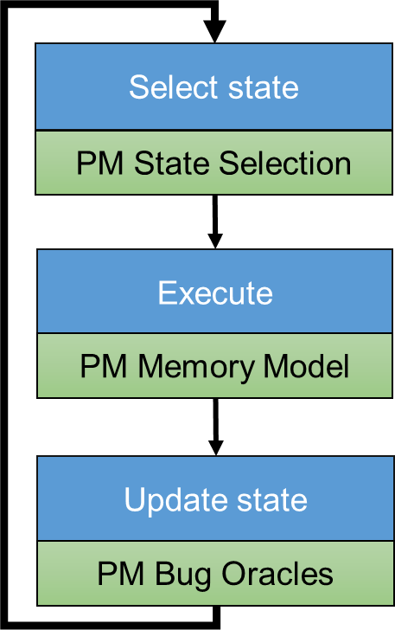
Our Contributions
Bug Study
Agamotto
Results
Symbolic Execution Engine (KLEE)
× 84 found
Application independent! No annotations!
(Automatic detection)
Symbolic Execution!
No test suite required!
(Accurate detection)
Reported to developers
Showed impact of performance bugs
(+47% throughput)

Slide 9
Overview
Bug Study
Agamotto
Results
Symbolic Execution Engine (KLEE)
× 84 found
Reported to developers
Showed impact of performance bugs
(+47% throughput)

Slide 10
PM Bug Study
Surveyed 63 previously recorded bugs
Most from PMDK’s issue tracker
Also analyzed bugs from PMTest, XFDetector
Identified two predominant patterns
Later use these to build bug detectors (i.e., bug oracles)

Slide 11
(1) Missing flush/fence
Example: oid should be made durable, but never is
Not making updates explicitly durable in PM
Not tied to any application-specific logic
Accounts for 79% of the bugs in our survey (50/63)
Not guaranteed to be false-positive free
We don’t discover any in our testing

Slide 12
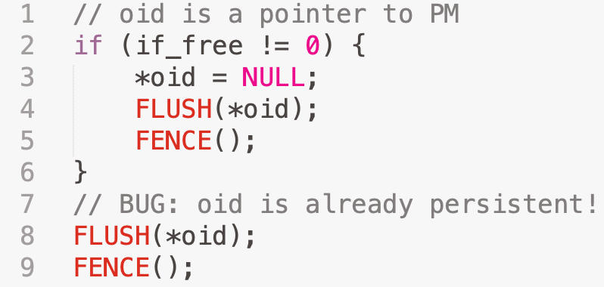
(2) Redundant flush/fence
Example: overuse of flush/fence instructions
Unnecessary use of durability mechanisms
Is a performance issue regardless of program logic
Accounts for 11% of the bugs in our survey (7/63)

Slide 13
Bug Study Conclusions
Two patterns, 90% of the bugs (57/63), are application independent!
Can automated their detection
Application-specific bugs, ~10% of the bugs (6/63), are still important
Allow developers to define their own patterns!
Pattern-based detection allows us to avoid source code modifications!

Slide 14
Overview
Bug Study
Agamotto
Results
Symbolic Execution Engine (KLEE)
× 84 found
Reported to developers
Showed impact of performance bugs
(+47% throughput)

Slide 15
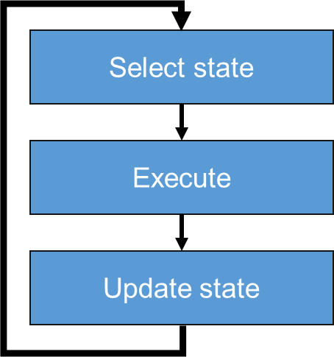
Overview
Agamotto
Symbolic Execution Engine (KLEE)

Slide 16
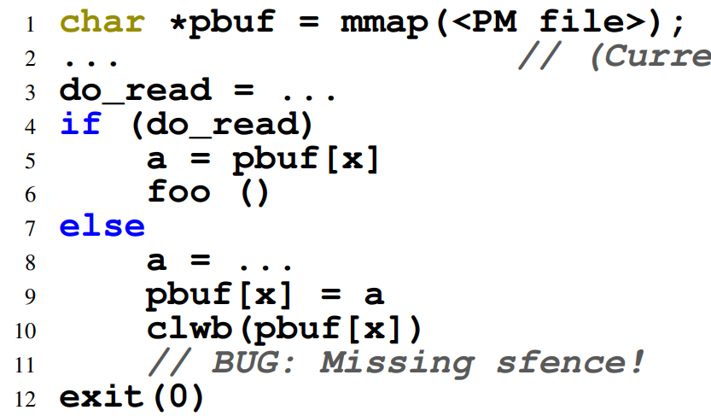
How Symbolic Execution Works
Select state
do_read = ?
do_read = 𝛌
Execute
Update state

Slide 17
How Symbolic Execution Works
Select state
do_read = 𝛌
do_read = 𝛌≠0
Symbolic execution gives us high code coverage!
(no need for extensive test suites)
Execute
do_read = 0
Update state

Slide 18
How does Agamotto work?
Select state
do_read = 𝛌≠0
Execute
pbuf[x]: clean
PM Memory Model
do_read = 0
Update state
pbuf[x]: dirty

Slide 19
(1) PM Memory Model
Augment symbolic memory model with PM state
Allocated from calls to mmap from pmem files
store
clean
dirty
flushed
store
flush
fence

Slide 20
How does Agamotto work?
Select state
do_read = 𝛌≠0
Execute
pbuf[x]: clean
PM Memory Model
Update state
do_read = 0
PM Bug Oracles
pbuf[x]: flushed

Slide 21
(2) PM Bug Detection
Augment PM state transitions with bug signals
missing
flush/fence
exit
exit
clean
dirty
flushed
flush
fence
redundant
flush/fence
flush

Slide 22
(2) PM Bug Detection
Custom oracles = custom state & signals
Example: ordering bug (A must be durable before B)
ordering
violation
store B
We use 2 custom oracles to reproduce all user-space application-specific bugs found from prior work!
(still no need to modify the source code!)
No bug
store B
store B
A: clean
B: clean
A: dirty
B: clean
A: flushed
B: clean

Slide 23
What else?
Agamotto
Symbolic Execution Engine (KLEE)
Why? To handle “State Space Explosion”!

Slide 24
Problem: State Space Explosion
…
…
How do we get here faster?
if
if
…
Drive symbolic execution towards states with the most PM operations! (because bugs = bad PM updates)
if
…
if
if
jmp
…

Slide 25
(3) PM State Selection
Select state
Priority: 2
PM State Selection
Priority: 2
do_read = 𝛌≠0
Priority: 0
In practice, <10% of instructions have non-zero priority!
Execute
pbuf[x]: clean
Priority: 0
PM Memory Model
Priority: 2
do_read = 0
Priority: 2
pbuf[x]: dirty
Priority: 1
Update state
PM Bug Oracles
Identify PM instructions (static analysis)
2. Assign unit weight
3. Back-propagate priorities

Slide 26
Design Summary
Agamotto
Symbolic Execution Engine (KLEE)
3. Select states based on PM priority to maximize chances of finding bugs
1. Create a model for PM and add to symbolic states
2. Add rules to detect application-independent bug signals

Slide 27
Overview
Bug Study
Agamotto
Results
Symbolic Execution Engine (KLEE)
× 84 found
Reported to developers
Showed impact of performance bugs
(+47% throughput)

Slide 28
Effectiveness
84 new bugs found so far (across 5 systems)
14 correctness bugs, 70 performance bugs
PM Search Strategy:
KLEE: after 1 hour, found 30% (25/84) bugs
Agamotto: finds all bugs in <40 minutes
Performance study on RECIPE [SOSP ’19]:
23−47% overall throughput increase in key-value store workloads!

Slide 29
Our Work
PM bug finding
Agamotto [OSDI ’20]
Finding PM bugs using PM-optimized symbolic execution
PM bug fixing
Hippocrates [ASPLOS ‘21]
Fixing durability bugs in PM programs with provably correct fixes

Slide 30
Is it enough to just find the bugs?
Even after automatically finding PM bugs, fixing them is difficult
23 days from report to fix, up to 66 days! (Study of PMDK bugs)
Bugs also found using a PM debugging tool (pmemcheck)
Challenging to balance trade-off between correctness and efficiency
Prevalence of work in PM debugging shows the prevalence of durability bugs in PM
General program repair techniques can introduce side-effects; don’t want accidentally introduce more crash consistency bugs!
Need to help PM developers fix these PM-specific bugs!

Slide 31
Correctly Fixing Bugs
Key insight: durability fixes primarily introduce memory orderings, which cannot introduce the possibility of new incorrect program behavior
Durability problems can be fixed, by definition, by adding cache flushes and/or memory ordering primitives
Adding these primitives has no impact other than restricting possible memory orderings
Restricting memory orderings doesn’t introduce new incorrect behavior
No new incorrect behavior, ergo no new bugs!
Based on this insight, we can automate the reasoning behind inserting efficient fixes while ensuring they are correct

Slide 32
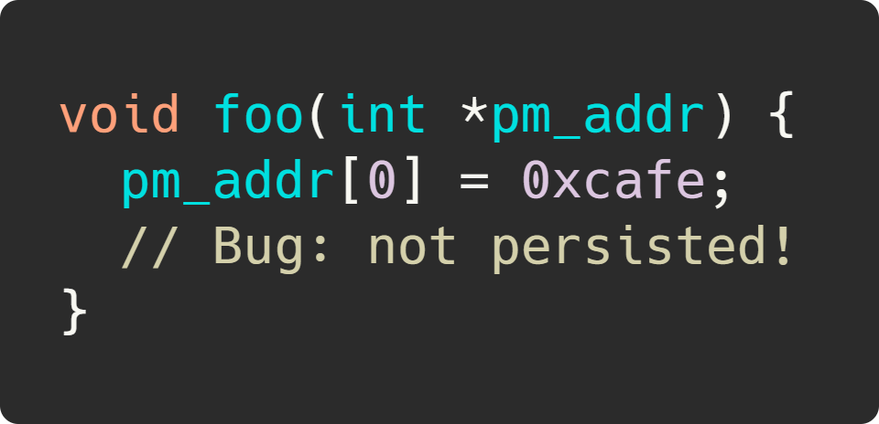
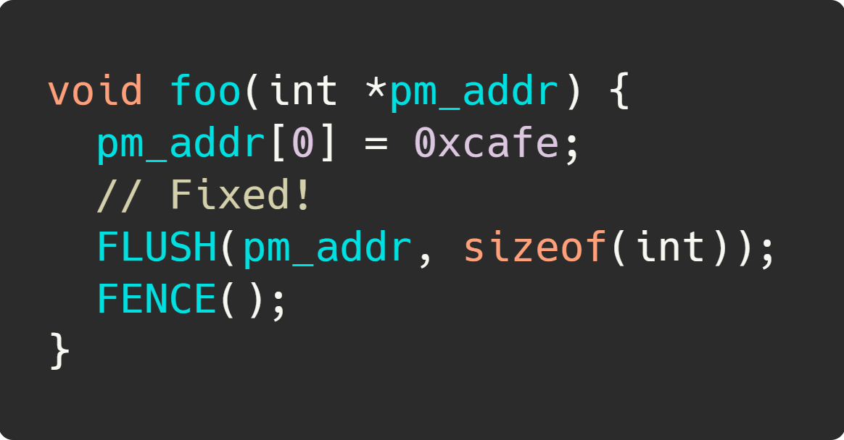
Fixing a Durability Bug
Can safely add all the flushes and fences we want!
Seems easy enough…
Results in 2-12x slowdowns!

Slide 33
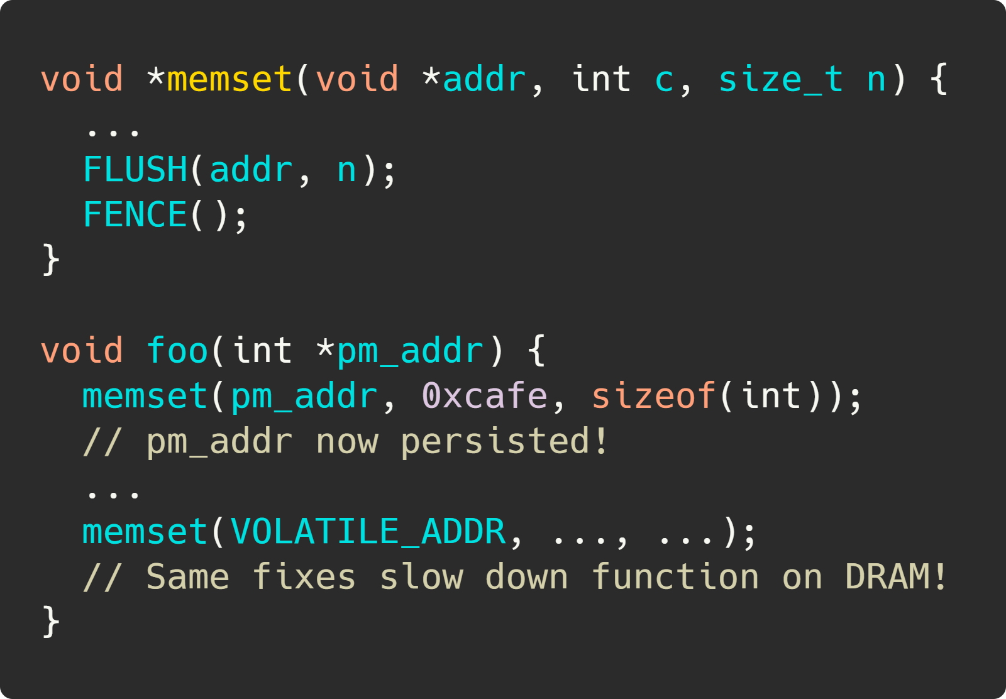
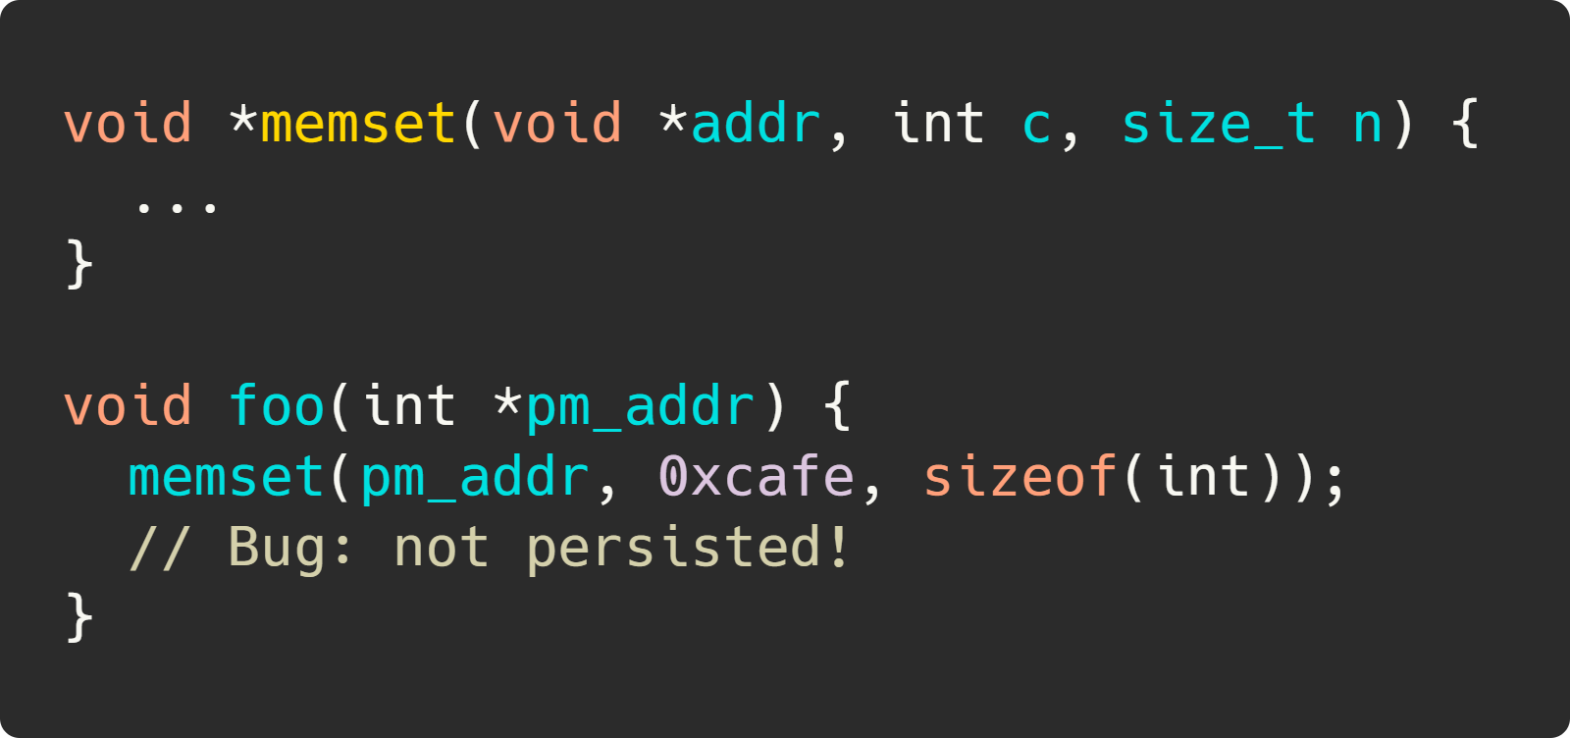
Performance Issues
Naïve fixes harm functions which operate on both PM and DRAM!
Solution: the Persistent Subprogram Transformation!

Slide 34
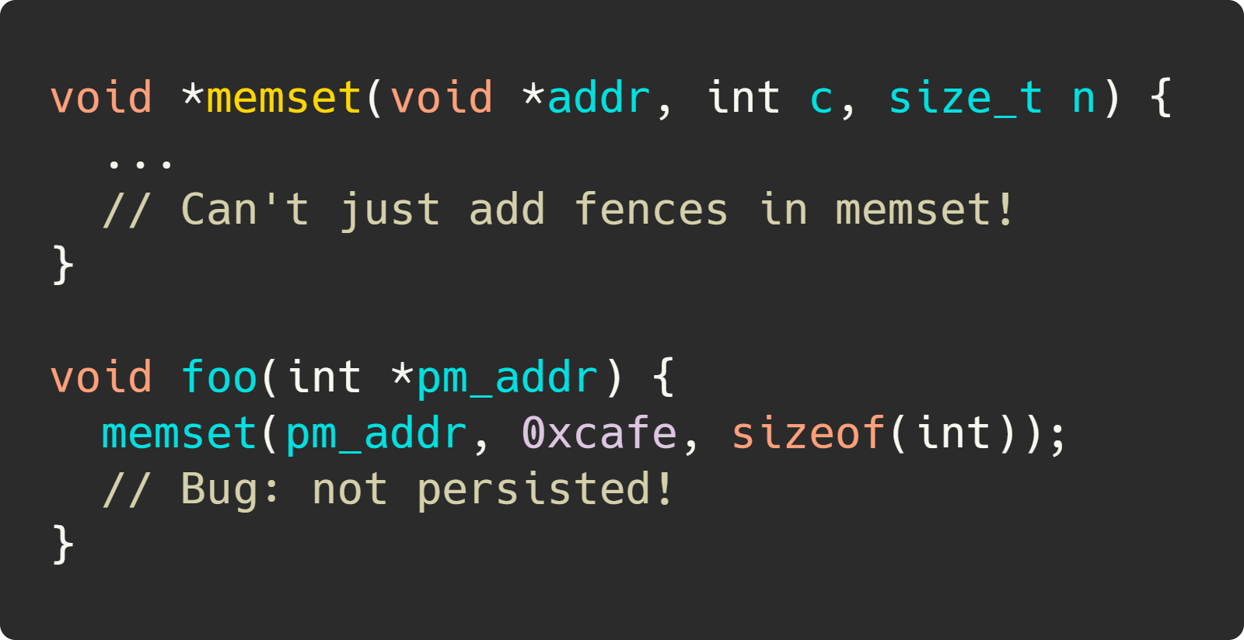
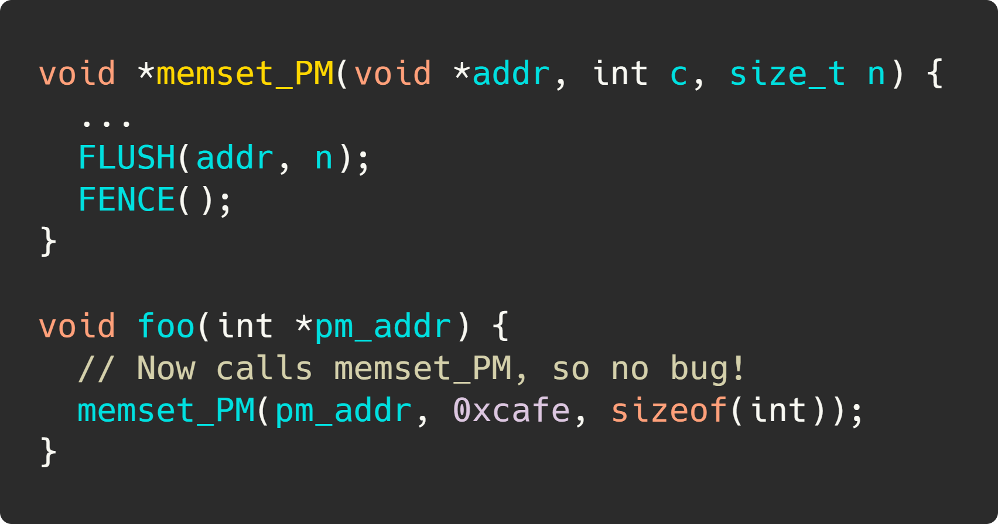
Persistent Subprogram Transformation
For cases where fixes may operate on PM, duplicate subprogram to minimize performance impact
This transformation is also provably correct!
Duplication preserves program semantics
After duplication, only insert flushes and fences!

Slide 35
Hippocrates
We built Hippocrates, an automated tool which takes input from bug finders like pmemcheck and Agamotto to automatically fix PM bugs
(Step 1) Parse bug finder trace
Computes simplest possible solution (flush/fence after offending store)
Ensures no duplicate fixes
Heuristically determines if fix should be elsewhere in call stack of error
Figure out where a fix would be least likely to operate on volatile memory
Heuristic also proven safe!
(Step 2) Identify bug locations
(Step 3) Compute fixes
(Phase 1) Compute intraprocedural solution
(Phase 2) Perform fix reduction
(Phase 3) Attempt to hoist fixes (heuristic)
(Step 4) Apply fixes and compile

Slide 36
Results
Fixes bugs correctly (“do no harm”) with efficient fixes
Compared against fixed PMDK bugs, Hippocrates fixes are effectively identical to manual fixes
Up to 7% performance increase over manually-crafted durability code compared to PM-port of Redis developed by Intel

Slide 37
Conclusion
PM bugs are prevalent and difficult to manually correct
We find 84 new PM bugs and show the potential impact of performance bugs, increasing throughput by 23−47% (Agamotto)
We automatically fix PM durability bugs and show that our fixes can outperform manual fixes by up to 7% (Hippocrates)

Slide 38
Thank you!
Contact: Ian Neal, iangneal@umich.edu

