Slide 1
Current-Sensing Efficient Adder for Processing-in-Memory Design
Joonseop Sim, Mohsen Imani, Woojin Choi, Yeseong Kim and Tajana Simunic Rosing

Slide 2
Conventional
Memory is just a storage device
Big data processing requires more computations to memory
Memory
Write
Processor
Channel
Read
Operation throughputs are limited by memory bandwidth

Slide 3
PIM approach
Put processing units inside memory
Memory
Write
Processor
Channel
PIM
Read
Relax the bandwidth bottleneck

Slide 4
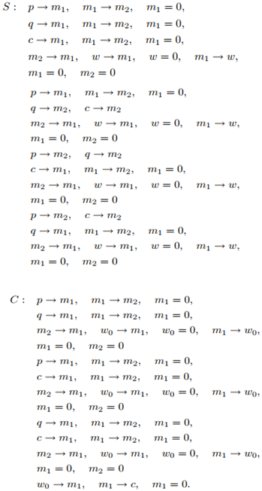
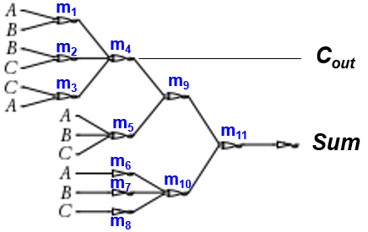
Prior Research on NVM-PIM
Bitwise Operations limited : e.g. Pinatubo[1], MPIM[2]
Not support arithmetic operations
Bitwise(NOR, IMP)-based ADD/MUL : e.g. MAGIC[3], Stateful logic[4]
Arithmetic functions with many cycles and intermediate states
Sum
C_{out}
12 cycles + 11 intermediate states
136 cycles + 134 intermediate states
[6] MAGIC, Mohsen Imani, et al, DAC 2017
[3] IMP, S. Kvatinsky, et al, VLSI, 2014
Cause much higher latency and extra cells consumption

Slide 5
This Work
Prior Work
(Bitwise ADD)
This Work (LUPIS)
Input
Input
Intermediate
Many
intermediate states
Many cycles
Single cycle ADD
Intermediate
Intermediate
Latency delay
Area penalty
Fast & no additional cell
Output
Output

Slide 6
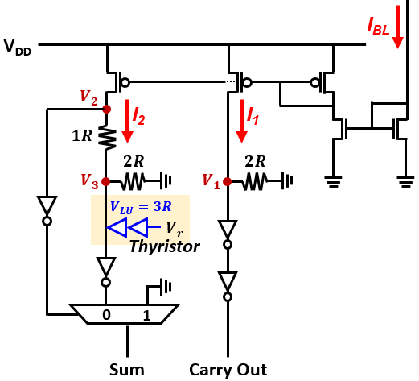
Design Overview
Chip
Bank
MAT
MAT
Bank
Row Decorder
Global Selector
W/B
Modified S/A
Bank I/O
Local Selector
Key contributions
Thyristor optimization (D)
Sensing circuits modification (C)
Efficient carry save addition (A)
Modified
Sensing Circuit

Slide 7
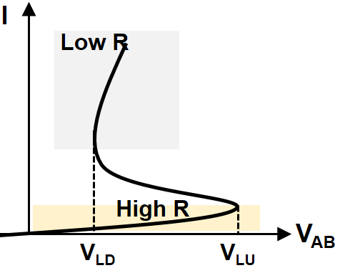
Thyristor Latch-Up
Design goal : To enable Sum (XOR) function in resistance sensing circuit
A
A
A
I_{short}
P
P
PNP
N
$$≡$$
N
N
$$≡$$
Gate
P
G
P
P
G
I
N
N
NPN
B
B
B
Thyristor
PNPN structure
equivalent to two cross-coupled bipolar junction transistors (BJTs)
When one of the two BJTs gets forward biased, it feeds the base of the other BJT
Latch-up occurs at V_{LU} and the current through the cell (i.e., from A to B) abruptly increases

Slide 8
Modified Sensing Circuit
A | B | C_{IN} | I_{BL}
0 | 0 | 0 | I₀₀₀
0 | 0 | 1 | I₁₀₀
0 | 1 | 0
1 | 0 | 0
0 | 1 | 1 | I₁₁₀
1 | 0 | 1
1 | 1 | 0
1 | 1 | 1 | I₁₁₁
Local Selector
When three rows are activated
I_{BL} are grouped into I₀₀₀, I₁₀₀, I₁₁₀, I₁₁₁ according to R_{low}(1) and R_{high}(0) combinations.

Slide 9
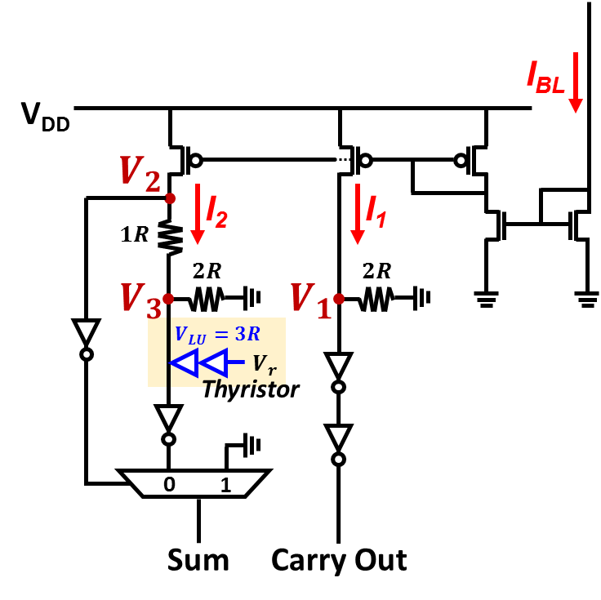
Modified Sensing Circuit
V
$$V_{1}=I_{1}∙(2R)$$
$V_{2}=I_{2}∙(3R$)
$$V_{3}=I_{2}∙\left(\frac{2R∙R_{thy}}{2R+R_{thy}}\right)$$
V_{DD}
V_{LU}
$$3R$$
$$2R$$
V_{THR}
$$\frac{2R∙R_{thy}}{2R+R_{thy}}$$
GND
I₀₀₀
I₁₀₀
I₁₁₀
I₁₁₁
I
C_{out}
0
0
1
1
A | B | C_{IN} | I_{BL} | C_{OUT} | Sum
0 | 0 | 0 | I₀₀₀ | 0 | 0
0 | 0 | 1 | I₁₀₀ | 0 | 1
0 | 1 | 0 |  | 0 | 1
1 | 0 | 0 |  | 0 | 1
0 | 1 | 1 | I₁₁₀ | 1 | 0
1 | 0 | 1 |  | 1 | 0
1 | 1 | 0 |  | 1 | 0
1 | 1 | 1 | I₁₁₁ | 1 | 1
Sum
0
1
0
1
C_{out} :
I_{BL} is copied to I₁
V₁ follow dotted line as I_{BL} → MAJ behavior
Sum :
I_{BL} is copied to I₂
0 at I₀₀₀ since V₂ < V_{THR}
1,0 at I₁₀₀,I₁₁₀ since V₃ follow blue line
1 at I₁₁₁ since V₃ drop due to thyristor latch-up
Notes:
V1, V2 font enlarge

Slide 10
Carry Save Addition : APIM[6]
Make N additions independent with no carry propagation
Propagate carry only in the last stage
3 inputs to 2 outputs (3:2) reduction
Interconnect
Interconnect
Interconnect
Drawback : Interconnect requires large number of transistors
→ Significant area overhead

Slide 11
Carry Save Addition : APIM[6] → LUPIS
LUPIS generates ADD results at the sensing circuits and writes them back to the memory directly.
X
Interconnect
X
Interconnect
X
Interconnect
LUPIS does not require the expensive interconnects

Slide 12
Experimental Setup
Device simulation : Sivaco ATLAS TCAD
Circuit-level simulations : Cadence Virtuoso and Spectre simulators with 45nm CMOS Technologies
VTEAM memristor model [5] for our memory design simulation:
R_{ON} and R_{OFF} of 10kΩ and 10MΩ respectively
Four OpenCL applications:
Sobel, Robert, Fast Fourier transform (FFT), DwHaar1D
Compared with state-of-the-art GPU (AMD Southern Island, Radeon HD 7970 device) and PIM Accelerator (APIM [6])

Slide 13
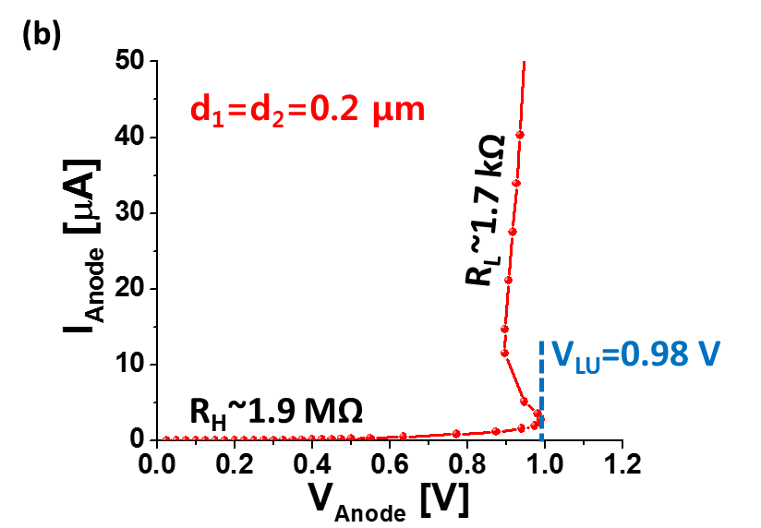
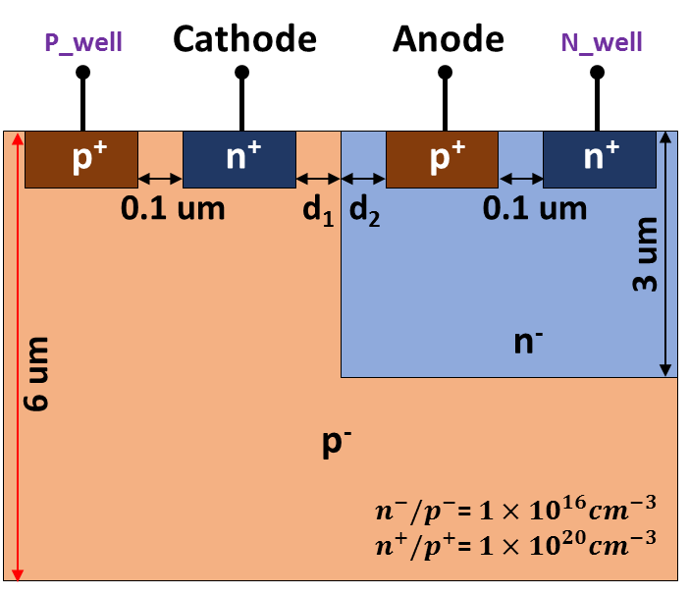
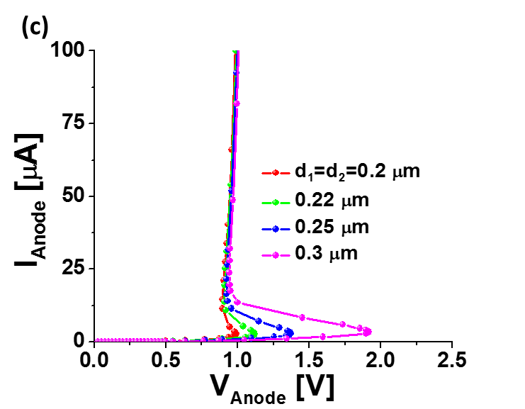
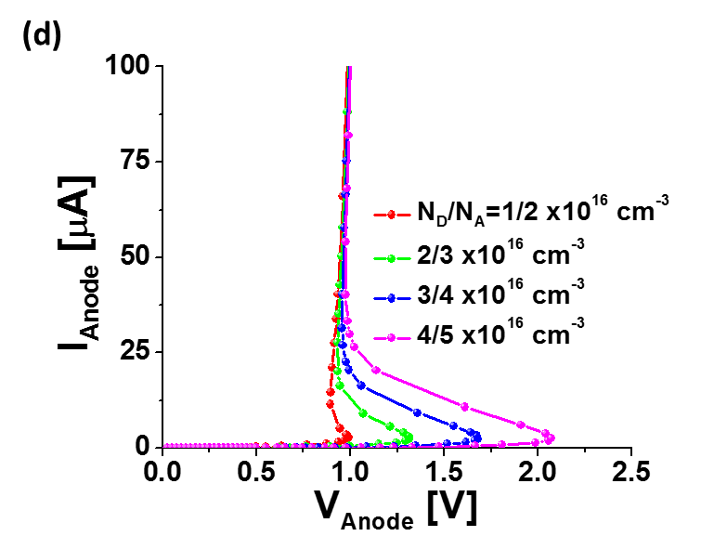
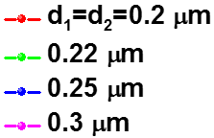
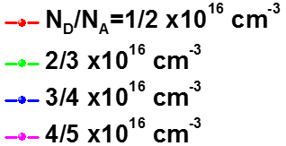
Device Simulation (by Silvaco)
Design a lateral PNPN structure
Process condition was optimized to get the conditions of a V_{LU} of 0.98 V, a R_{H} of 1.9 MΩ, and a R_{L} of 1.7 KΩ
Achieved process window by tuning the N_{D}/N_{A} and d₁/d₂

Slide 14
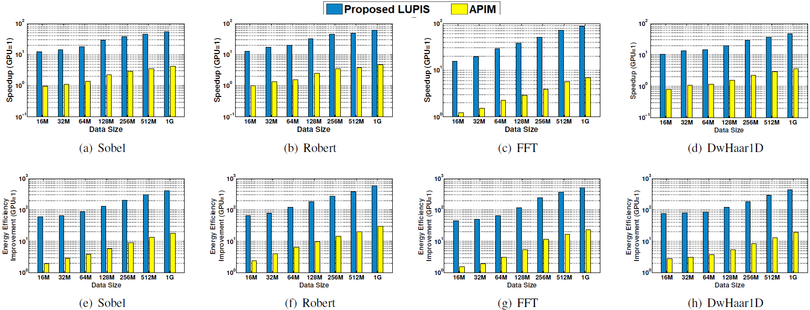
Energy and Performance
Performance of 1-bit Adder for LUPIS and other technologies
 | [4] | [3] | [6] | [7] | This Work
No. Memristors | 3N+5 | 3N+3 | 3N+8 | N+2 | 3N
No. Cycles | 136 | 29 | 13 | 9 | 1
Cell efficiency | 38% | 50% | 27% | 33% | 100%
Latency | 149.6ns | 31.9ns | 14.3ns | 9.9ns | 33.3ps
Energy | 3237fJ | 690fJ | 289fJ | 214fJ | 7.9fJ
Proposed LUPIS achieved superior cell efficiency, speedup and lower energy consumption due to a single cycle ADD with no extra cell penalty.
As compared to the state-of-the PIM accelerator [6], the results present 12.7X and 20.9X higher efficiency for speedup and energy respectively .
Notes:
Put just 2 line, text

Slide 15
Overhead
2
Overhead
LUPIS has 21% area overhead, 15x better than the APIM [6] since no additional cells are required and it took insignificant modifications to the conventional CSA circuit.
Latency overhead is just one cycle caused by the write back inclusion
Notes:
Text
Yeseong

Slide 16
Conclusion
We presented a high performance PIM technology by enabling single-cycle ADD and improving the MUL performance.
Our design addresses the low cell-efficiency of other PIM technologies by executing the calculations in the sensing circuitry.
Proposed design can achieve 12.7X speed up, 20.9X lower power consumption compared to a state-of-the-art PIM accelerator.

Slide 17
Reference
[1] S. Li, C. Xu, Q. Zou, J. Zhao, Y. Lu, and Y. Xie, “Pinatubo: A processing-in-memory architecture for bulk bitwise operations in emerging non-volatile memories,” in Design Automation Conference (DAC), 2016
[2] M. Imani, Y. Kim, and T. Rosing, “Mpim: Multi-purpose in-memory processing using configurable resistive memory,” in Design Automation Conference (ASP-DAC), 2017 22nd Asia and South Pacific, pp. 757–763, IEEE, 2017
[3] S. Kvatinsky, G. Satat, N. Wald, E. G. Friedman, A. Kolodny, and U. C. Weiser, “Memristor-based material implication (imply) logic: Design principles and methodologies,” IEEE Transactions on Very Large Scale Integration (VLSI), 2014
[4] E. Lehtonen and M. Laiho, “Stateful implication logic with memristors,” in Proceedings of the 2009 IEEE/ACM International Symposium on Nanoscale Architectures, pp. 33–36, IEEE Computer Society, 2009.
[5] S. Kvatinsky et al., “Vteam: a general model for voltage-controlled memristors,” TCAS II, vol. 62, no. 8, pp. 786–790, 2015.
[6] M. Imani, S. Gupta, and T. Rosing, “Ultra-efficient processing inmemory for data intensive applications,” in Proceedings of the 54th Annual Design Automation Conference 2017, p. 6, ACM, 2017
[7] A. Siemon, S. Menzel, R. Waser, and E. Linn, “A complementary resistive switch-based crossbar array adder,” IEEE journal on emerging and selected topics in circuits and systems, vol. 5, no. 1, pp. 64–74, 2015.

Slide 18
Backup slides

Slide 19
Overhead
Overhead
[7]
[7]
LUPIS has 21% area overhead, 10x better than the TC-Adder [7] since no additional cells are required and it takes insignificant modifications to the conventional CSA circuit.
Latency overhead is just one cycle caused by the write back inclusion
Notes:
Text
Yeseong

