Slide 1
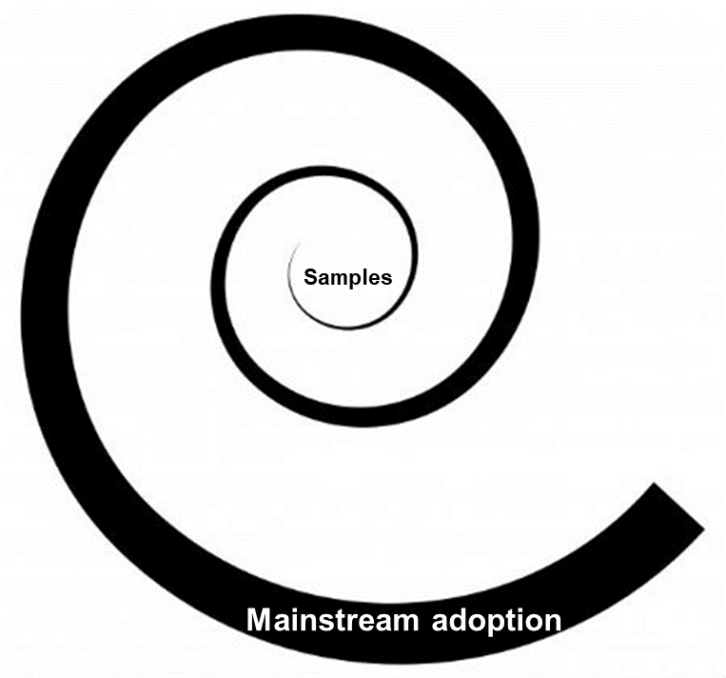
Persistent Memory From Samples to Mainstream Adoption
Golander Amit, PhD

Slide 2
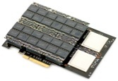
Storage Media Generations
IOPS (even if random…)
Latency (even under load…)
PM
HDD
FLASH
NVDIMM / PM / NVMM
Memory
Speed
Storage
Persistency
PM marries the best of both worlds:
+

Slide 3
Gradual PM Adoption
HW
SW Vendor Example
Density Cost
[GB] [$/GB]
Samples
2013
2015
2017
2019
HW standards
X0s >>DRAM
Drivers & OSs
SW infrastructure
& on par features
X00s >DRAM
x000s <DRAM
BOM reduction
Mainstream adoption
Notes:
HW – SNIA NVDIMM SIG, JEDEC 4 pins, DDR4 ref board, ACPI

Slide 4
Agenda
Past
Hardware definitions
Software approaches
Future - Accelerate Adoption
Past
Future

Slide 5
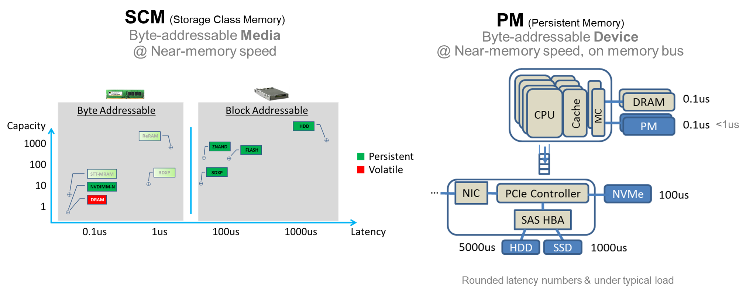
PM Hardware

Slide 6
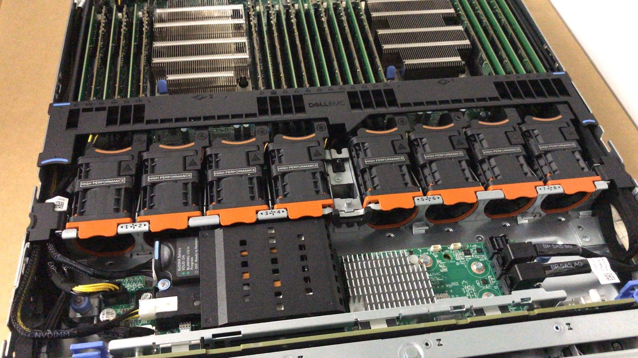
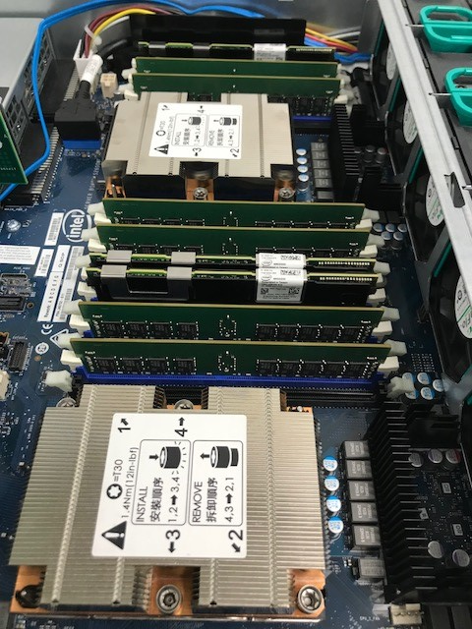
PM Hardware – 2017/8
Fast PM
NVDIMM-N
Mother board level
Slow(er) PM
SCM-based NVDIMMs

Slide 7
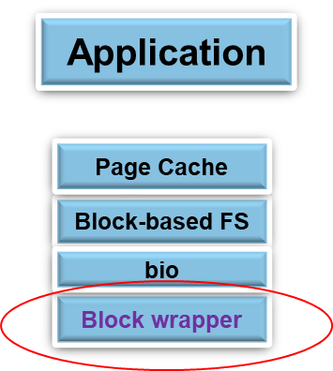
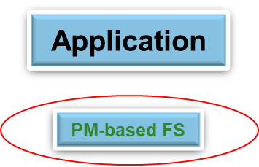
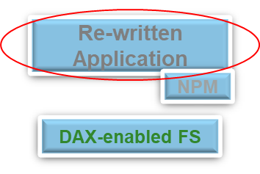
PM-based SW Approached
SW reuse
Performance
Application
SW Infrastructure
HW
PM
PM
PM
Notes:
Can also mention language extensions

Slide 8
Memory Accelerated (MAX) Data™
language extension
Applications
SPDK
Plexistor (acquired by NetApp)
PM-based FS pioneer since 2013
Contributed/ing some of our IP
MAX Data approach:
Support legacy applications & Enable NPM (e.g. SPDK)
Feature rich
Integrate with NetApp Data Fabric™
I/O semantics
Memory semantics
Page Cache
PM-based FS
DAX-enabled FS
Block-based FS
e.g. MAX FS
bio
…
Block wrapper
PM

Slide 9
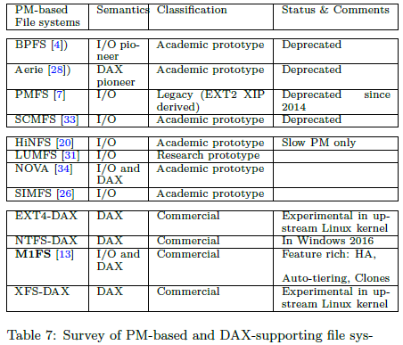
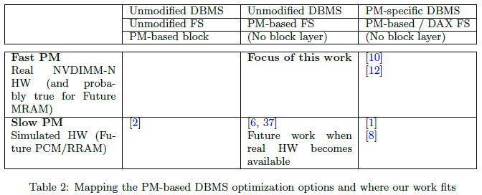
PM/DAX FS - Room for Innovation
12 flavors in a decade
Most developed wo/ real SCM
Half are deprecated Half of the rest are DAX only
(MAX FS)
Katzburg et al. Submitted to SYSTOR 2018, Pending. An Experimental Study of NVDIMM-N Persistent Memory and its Impact on Two Relational Databases

Slide 10
Agenda
Past
Future - Accelerate Adoption
Reduce Bill of materials (BOM)
On par Data Protection (DP)
Larger SW eco system
Past
Future

Slide 11
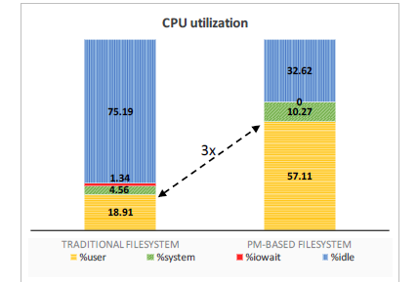
BOM 1
Reduce BOM
On par Data Protection
Larger SW eco system
Fast PM – Limited Capacity
Slow PM – Still Expensive
Which is best for which Application?
Offset PM BOM by saving on DRAM and CPU
Offset PM BOM by using Lower Tiers
Katzburg et al. ICSEE 2016 Storage becomes first class memory
Average Storage Access Time:
A.S.A.T = PM_{Latency} + PM_{MissRate}* Flash_{Latency}

Slide 12
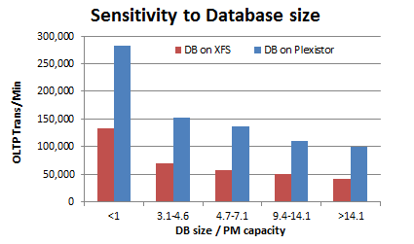
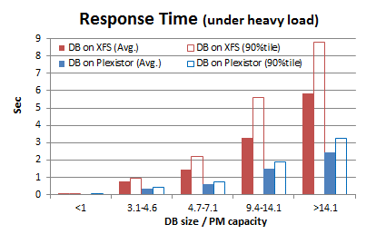
BOM 2: Auto-Tiering between PM & Flash
Benchmark
Application Server
DBT-2
Postgres 9.5
MAX Data
Server
PM
Flash +

Slide 13
Data Protection is Expected
Reduce BOM
On par Data Protection
Larger SW eco system
DP on the application server
Single Fault Tolerance @ near-memory speed
Snapshot-based DP

Slide 14
1. DP on the Application Server
First line of defense
Hardware
Memory controller
NVDIMM controller
Software
Local FS
Xu et al. NVMW 2018
NOVA: A High-Performance, Fault-Tolerant File System for Non-Volatile Main Memories

Slide 15
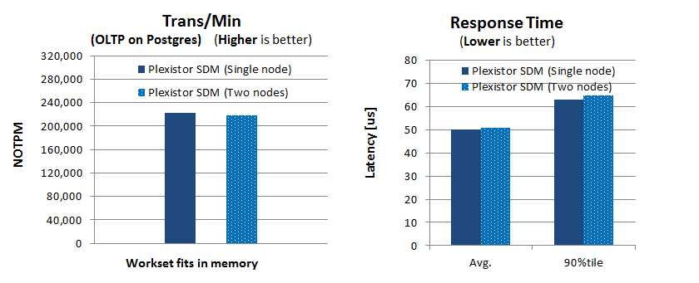
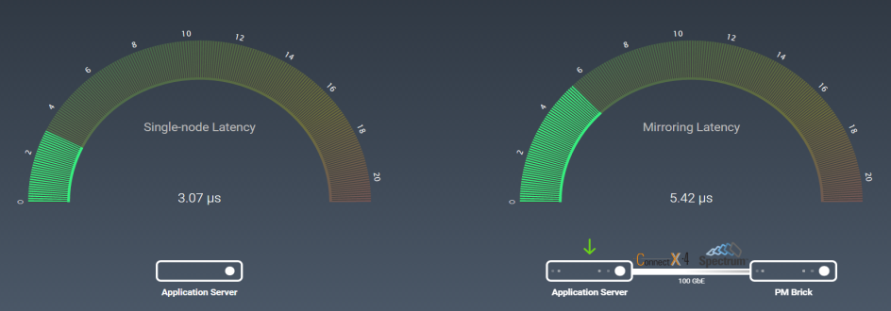
2. Single Fault Tolerance @ Near-memory Speed
Example
NetApp MAX Recovery™ feature
No application modification required
Negligible Performance Degradation for real applications
Few extra µs Penalty
Golander et al. Poster at SYSTOR 2017 Persistent Memory over Fabric (PMoF)

Slide 16
3. Snapshot-based Data Protection
Example
MAX Sync™ feature leverages NetApp Data Fabric™ DP:
Disaster Recover - SnapMirror
Backup - SnapVault
Auditing - SnapLock
MAX Data
ONTAP
Additional synergy examples:
ONTAP data reduction (e.g. compression)
Ontap resiliency (e.g. RAID-TED)
Ease of administration (e.g. hide cultural gap)

Slide 17
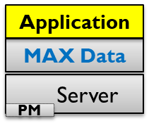
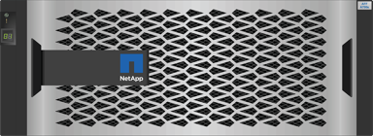
By Product: Ease of Administration
Bridging cultural gaps, by automation & hiding complexity
Application Admins
- Many
- Care about their application
MAX Data UI
…
Cultural gap
Storage Admin/s
- Few storage expert
- Care about corporate DP policies
Data Fabric UI

Slide 18
Larger SW Eco System – Why?
Reduce BOM
On par Data Protection
Larger SW eco system
PM SW Market
SW Innovation (Many players)
Accelerate PM Adoption
HW Cost (few big vendors)

Slide 19
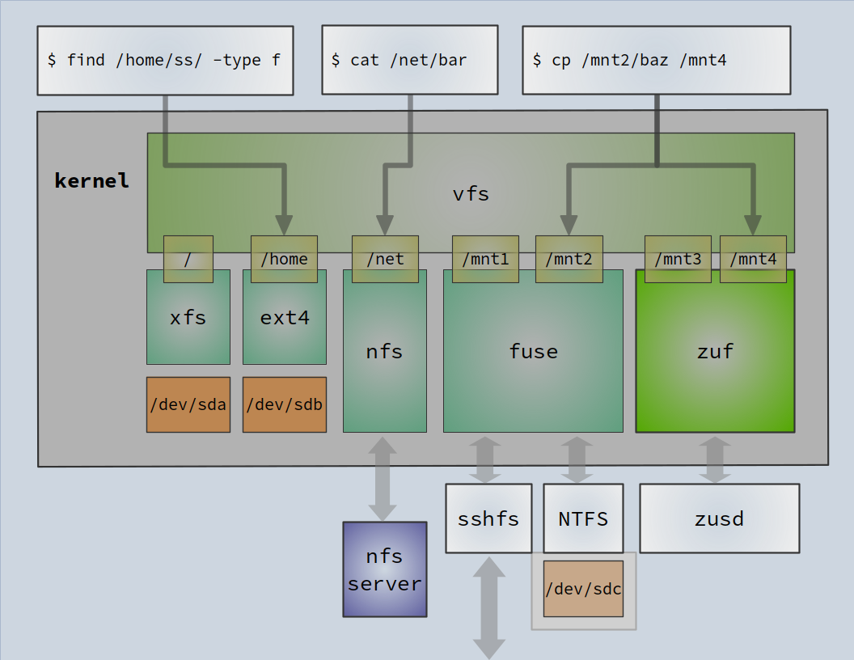
Kernel Vs. User Space FS Implementation
Kernel
Fast (shortest path)
User space
Portable
Resilient (contained)
Simpler to add functionality & Debug
Fewer licensing restrictions
Kernel FS
K-U Bridges
The gap: Near-memory speed Kernel-to-User bridge

Slide 20
Why not extend FUSE to PM?
FUSE architecture is great for HDDs and ok(ish) for SSDs, but not suitable for PM
HDD
Flash
PM
Memory
$/GB
Latency
TCP
RDMA
FUSE
?
 | FUSE | ZUFS
Typical medias | Built for HDDs & extended to Flash | Built for PM/NVDIMMs and DRAM
SW Perf. goals | Secondary (High latency media) Async I/O Throughput | SW is the bottleneck Latency is everything
SW caching | Slow media -> Rely on OS Page Cache | Near-memory speed media -> Bypass OS Page Cache
Access method | I/O only | I/O and mmap (DAX)
Cost of redundant copy / context switch | Negligible | The bottleneck -> Avoid copies, queues & remain on core
Latency penalty under load | 100s of µs | 3-4 µs
Design Assumptions

Slide 21
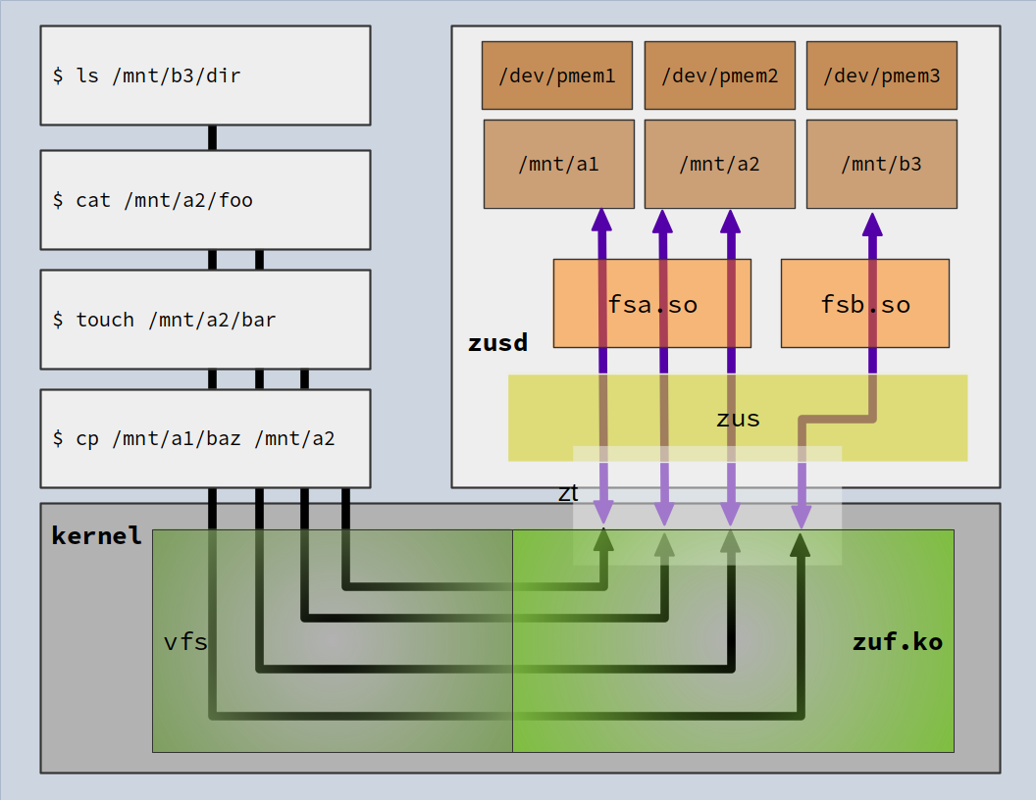
ZUFS Features & Architecture
Low latency & Efficient
Core & L1 cache affinity
Zero data copy
Manages devices
Optimal pmem access
NUMA aware
Data mover to lower tier devices
Page table mapping supports I/O & DAX semantics
Misc
Async hook available
System service
Notes:
Optimal pmem access = special file, direct-io mmap the device

Slide 22
Preliminary Results (for PM)
Measured on
Dual socket, XEON 2650v4 (48HT)
DRAM-backed PMEM type
Random 4KB DirectIO write access

Slide 23
Conclusions
2018 is the year for PM as COTS (commodity of the shelf)
Mass adoption needs more innovation:
Hardware
SCM-based NVDIMM vendors
AMD and ARM support
Software
ZUFS is a key enabler
Kernel-to-User bridge designed for PM https://github.com/NetApp/zufs-zus & zufs-zuf

Slide 24
Thank you

Slide 25
Abstract
Persistent Memory (PM) is near-memory speed storage that provides byte-addressable granular access. PM disruption extends beyond the hardware itself and is revolutionizing storage software and operating system I/O stack. Moreover, it may even shift traditional responsibilities from the storage to the application administrator.
In this talk, we will survey the software approaches for leveraging PM, focusing on the approach Plexistor (acquired by NetApp) chose and why. We will describe some of the steps NetApp is taking to usher PM into mainstream adoption, such as offsetting PM costs using auto-tiering; providing advanced data protection schemes; and increasing portability by contributing a new kernel-to-user space file system bridge called ZUFS.

