Slide 1
Codes for Correcting Tandem Repeats
Johan Chrisnata, Nanyang Technological University, Singapore
arXiv:1707.03956
Joint work with
Yeow Meng Chee,
Han Mao Kiah,
Tuan Thanh Nguyen.

Slide 2
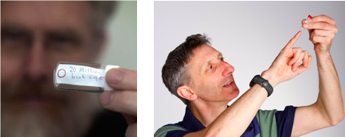
DNA storage: the code that could save civilization
Recent experiments demonstrating feasibility of storing information
Goldman et al. (2013): density 2x10¹⁵ B or 2PB/gram,
Goldman: “All of the world’s data would fit in the back of a minivan” (BBC interview – 24 Jul 2013),
Shipman et al. (2017) : CRISPR-Cas, encoding of a digital movie into the genomes of a population of living bacteria.

Slide 3
DNA storage: the code that could save civilization
Advantages:
High storage density,
Extremely durable,
Low maintenance.

Slide 4
Common mutation in DNA of living organisms
More than 50% of the genome contain repeated substrings.
Two types of common repeats:
Interspersed : inserting a copy of a segment of DNA anywhere.
Tandem : inserting a copy of a segment of DNA adjacent to the original position.
AGTCTCG
AGTCTAGTCG
$$x=$$
AGTCTCG
AGTAGTCTCG
is a $3−descendant$ of $x.$

Slide 5
Decoding tandem repeats by deduplication
abc
abcc
…
aaabbbccc
Codeword
Received word
Decoded

Slide 6
Confusability of words
Two words are said to be confusable under tandem duplication of length at most k or $≤k−confusable,$if they can generate a common word under some sequence of tandem duplications of length at most $k$.
AGTCTCGG
AGTAGTCTCGG
AGTTAGTCTCGG
AGTTAGTCG
AGTTAGTCTCG
$$≤3−confusable$$

Slide 7
Questions to ask :
When are two words confusable under tandem duplications ?
Included in the full version of this paper are :
Sufficient and necessary condition for two words to be at-most-three confusable ,
Linear time algorithm to determine the at-most-three confusability of two words,
Improved lower bounds for code construction for tandem duplications of length at most three.

Slide 8
Some definitions
$abcbabcbabcbc$
$≤4−ancestor cone$ of $x=D_{≤4}^{−∗}(x)$.
$$≤4−irreducible words={Irr}_{≤4}(q)$$
$abc$
$abcbc$
$$x=abcbabcbc$$
$≤4−descendant cone$ of $x=D_{≤4}^{∗}(x)$.
$abcbabc$
$aabbcbabcbc$
$≤4−root$ of $x$ =$R_{≤4}(x)$ =$D_{≤4}^{∗}\left(x\right)∩$ ${Irr}_{≤4}(q)$

Slide 9
Code Construction
abc
abcc
…
Codeword
NO COMMON DESCENDANT
babac
…
bac
For all $x,y in the code, D_{≤k}^{∗}\left(x\right)∩D_{≤k}^{∗}\left(y\right) =∅.$

Slide 10
PROPERTIES OF TANDEM DUPLICATION

Slide 11
Tandem duplication of length exactly $k$
For $x∈Σ_{q}^{n}$, let $φ_{k}\left(x\right)=\left(Pre{fix}_{k}\left(x\right), Suffix_{n−k}\left(x\right)−Pre{fix}_{n−k}\left(x\right)\right)$ .
$φ_{3}\left(012 012 012 210 20\right)$=(012, 000 000 201 02)
$φ_{k}$ is a bijection from $Σ_{q}^{n}$ to $Σ_{q}^{k}×Σ_{q}^{n−k}$.
$012 210 20$
TD of length 3
$$012 012 012 210 20$$
$$φ_{3}$$
$$φ_{3}$$
Insertion of 3 consecutive zeroes
$$(012 , 201 02)$$
$$(012 , 000 000 201 02)$$

Slide 12
Finding $k−root$ of a word $x$
$$x$$
$$φ_{k}^{−1} ((y,z))$$
$$φ_{k}$$
$$φ_{k}^{−1}$$
$$φ_{k} (x)$$
Remove all consecutive $k$ zeroes
$$(y,z)$$

Slide 13
Length of Duplications allowed | Uniqueness of root | Common Descendant implies Common Root | Common Root implies Common Descendant | Code Construction
Exactly k | YES | YES
Up to $k, k≤2$
Up to $k, k=3$
Up to $k, k≥4$

Slide 14
Common root implies common descendant
$$(012 , 000 200 001 02)$$
$$(012 , 201 02)$$
$$(012 , 000 200 001 020 00)$$
$$(012 , 201 02 000)$$

Slide 15
Length of Duplications allowed | Uniqueness of root | Common Descendant implies Common Root | Common Root implies Common Descendant | Code Construction
Exactly k | YES | YES | YES | OPTIMAL
Up to $k, k≤2$
Up to $k, k=3$
Up to $k, k≥4$

Slide 16
Uniqueness of root for TD of length $≤k$, where $k≤3$
aabc
aaabcbc
aaabbbccc
abc
aabbcc
Unique root
abcabc
aaabababcbc

Slide 17
Common root implies common descendant for TD of length $≤k$, where $k≤2$
aaabbbccccc
aaabababbbcbccccc
abc
aaabababcbc
Common root
Common descendant

Slide 18
Different root implies different descendant for TD of length $≤k$, where $k≤3$
aabcc
abc
…
Different root
No common descendant
babac
…
bac

Slide 19
Length of Duplications allowed | Uniqueness of root | Common Descendant implies Common Root | Common Root implies Common Descendant | Code Construction
Exactly k | YES | YES | YES | OPTIMAL
Up to $k, k≤2$ | YES | YES | YES | OPTIMAL
Up to $k, k=3$
Up to $k,k≥4$

Slide 20
Length of Duplications allowed | Uniqueness of root | Common Descendant implies Common Root | Common Root implies Common Descendant | Code Construction
Exactly k | YES | YES | YES | OPTIMAL
Up to $k, k≤2$ | YES | YES | YES | OPTIMAL
Up to $k, k=3$ | YES | YES
Up to $k,k≥4$

Slide 21
Common root but different descendant for k=3
abbc
No c before a
abc
abcabc
Has c before a
the common root

Slide 22
Length of Duplications allowed | Uniqueness of root | Common Descendant implies Common Root | Common Root implies Common Descendant | Code Construction
Exactly k | YES | YES | YES | OPTIMAL
Up to $k, k≤2$ | YES | YES | YES | OPTIMAL
Up to $k, k=3$ | YES | YES | NO | LB
Up to $k,k≥4$

Slide 23
When duplication of length more than 3 occur
One word may have more than 1 root
abc
abcbabcbc
abcbabc
Different root does not imply different descendants, because there may be more than one root.

Slide 24
Length of Duplications allowed | Uniqueness of root | Common Descendant implies Common Root | Common Root implies Common Descendant | Code Construction
Exactly k | YES | YES | YES | OPTIMAL
Up to $k, k≤2$ | YES | YES | YES | OPTIMAL
Up to $k, k=3$ | YES | YES | NO | LB
Up to $k,k≥4$ | NO | NO | NO | NO RESULT

Slide 25
Provide the necessary & sufficient conditions for two word with common root but generate different descendants.
Provide a linear time algorithm to test any two random words if they are confusable or not.
Construct codes with larger size compare to previous result
Provide an algorithm to search for optimal code.
Length of Duplications allowed | Uniqueness of root | Common Descendant implies Common Root | Common Root implies Common Descendant | Code Construction
Exactly k | YES | YES | YES | OPTIMAL
Up to k, $k≤2$ | YES | YES | YES | OPTIMAL
Up to k, $k=3$ | YES | YES | NO | LB
Up to k, $k≥4$ | NO | NO | NO | NO RESULT

Slide 26
Length of Duplications allowed | Uniqueness of root | Common Descendant implies Common Root | Common Root implies Common Descendant | Code Construction
Exactly k | YES | YES | YES | OPTIMAL
Up to k, $k≤2$ | YES | YES | YES | OPTIMAL
Up to k, $k=3$ | YES | YES | NO | LB
Up to k, $k≥4$ | NO | NO | NO | NO RESULT
Provide a method to construct code with good rate (when q is large enough)
Decoding has linear running time

Slide 27
More notations and terminology
Let $r∈{Irr}_{≤k}\left(q,n\right)$, we define $main(r)$ to be the first substring in $r$ that has three distinct symbols.
Let $Reg(r)$ denote the longest prefix of $r$ that repeats the pattern of $main\left(r\right)$ after $main\left(r\right)$.
Example : If $r=1 012 01 02 ,$ then $main\left(r\right)=012$ , and $Reg\left(r\right)=101201$.

Slide 28
More notations and terminology
Suppose $Reg(r)$ can be written as $w{\left(abc\right)}^{ℓ}ab=1{\left(012\right)}^{1}01$, then we define the extended region of $r$ in $x$, $Ext\left(Reg\left(r\right),x\right)$ to be the longest prefix of $x$ that is generated from $Reg(r)$ through a sequence of tandem duplications of length at most three.
Suppose $Ext\left(Reg\left(r\right),x\right)=p_{1}p_{2}⋯p_{t}=p$, and let $p_{i}$ be the last appearance of $a$ in $p$,
then we define $∗Pref\left(r,x\right)$ be defined as $p_{1}p_{2}⋯p_{i−1}$.

Slide 29
$$∗Pref(r,x)$$
$$u=x∖∗Pref(r,x)$$
Main Idea of the Algorithm
01102021
0120111
$$main(r)$$
$$x$$
02
$$r$$
$$r\underset{≤3}{\underset{⇒}{∗}}x$$
$$Ext(Reg\left(r\right),x)$$
102
01
0
$$Reg\left(r\right)\underset{≤3}{\underset{⇒}{∗}}Ext\left(Reg\left(r\right),x\right)$$
$$Reg(r)$$

Slide 31
$$u=x∖∗Pref(r,x)$$
$$∗Pref(r,y)$$
$$v=y∖∗Pref(r,y)$$
$$∗Pref(r,x)$$
0120111
012001
01102021
02
02
$$y$$
01
$$x$$
$$Ext(Reg\left(r\right),x)$$
$$Ext(Reg\left(r\right),y)$$
$Ext\left(Reg\left(r\right),x\right)$ and $Ext\left(Reg\left(r\right),y\right)$ are $≤3−confusable,$
$u$ and $v$ are $≤3−confusable,$
Implies that $x$ and $y$ are $≤3−confusable,$

Slide 32
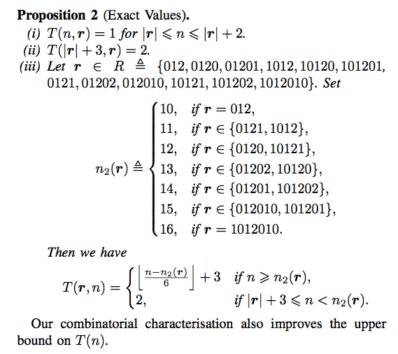

Slide 33
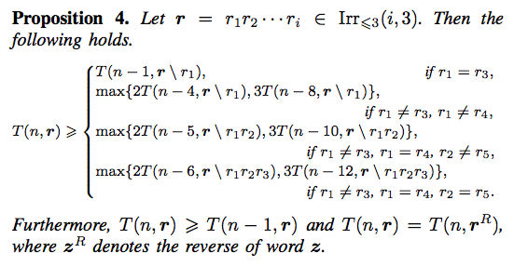

Slide 34
Previous Work on $\left(n, ≤k;q\right)−$ TD code for k=2,3
Jain et al. used irreducible words to construct TD codes and demonstrate that the construction is optimal for $k=2$.
$T\left(n,2;3\right)=Σ_{i=1 }^{n}\left|Irr_{≤2}\left(i,q\right)\right|,$
Construction 1 : $T\left(n,3;3\right)≥Σ_{i=1 }^{n}\left|Irr_{≤3}\left(i,3\right)\right|$. ( lower bound )
Proposition 1 : $T\left(n,3;3\right)≤T\left(n,2;3\right)$. ( upper bound )

Slide 35
Thank You

